Slide 1
Learning Provider Regional Forums
FE Account Managers
Partner Services
2026

Slide 2
Agenda
SLC updates
Trends and analysis
Managing funding
FE funding landscape
Overview of sector performance
Academic year 26/27 preparation

Slide 3
Student Loans Company
Updates

Slide 4
SLC Updates
2026/27 application service launch – planned for early June (date TBC)
Home Office Data Share (HODS) – over 80% eligibility check success rates for non-UK Nationals
Digital Student Finance Service (DSFS) –
New assessment platform developed to deliver LLE
All student finance products to be migrated to this platform in stages, including ALL for 27/28
This will enable digital upload functionality
We will share further information in due course
ALL Service Standards – updated Summer 2025 to simplify and streamline compliance targets

Slide 5
Student Loan Repayment
Plan 5 from August 2023
£25k threshold
Repay at 9% over threshold
Cancelled after 40 years
Interest RPI during study

Slide 6
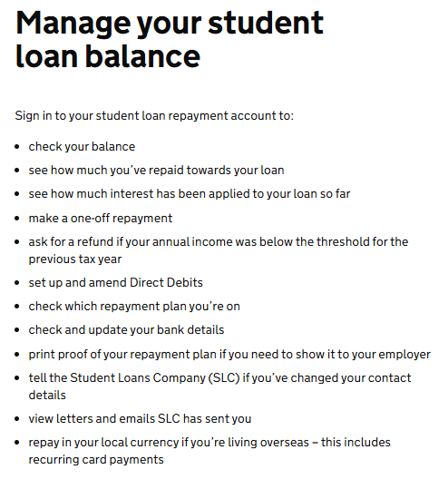
Student Loan – Managing the balance
Learners can visit gov.uk to check loan balance
To sign in, they will need:
customer reference number or email address
password
secret answer, for example your mother’s maiden name
Manage your student loan balance - GOV.UK

Slide 7
Student Loans Company
Trends & Analysis

Slide 8
Partners Support Desk - Contact Drivers
Admin errors / portal admin queries
Reverse withdrawal requests
Application / evidence queries
Level 3 entitlement

Slide 9
Application Volumes - Comparison
 |  | 20/21 | 25/26
 |  | 21/01/2021 | 22/01/2026
Total Applications Submitted |  | 68,247 | 23,140
Processed | Approved | 47,107 | 18,849
 | Withdrawal/Suspension | 2,466 | 1,165
 | Ineligible | 3,064 | 1,510
 | Auto Cancelled | 4,614 | 1,038
Total Processed |  | 57,251 | 22,562
Outstanding | Awaiting Evidence | 1,650 | 375
 | Awaiting Investigation | 139 | 65
 | Work In Hand | 169 | 138
Total Outstanding |  | 1,958 | 578
Data Entry Incomplete |  | 928 | 652
Auto Cancelled - Data Entry Incomplete |  | 8,110 | 4,751

Slide 10
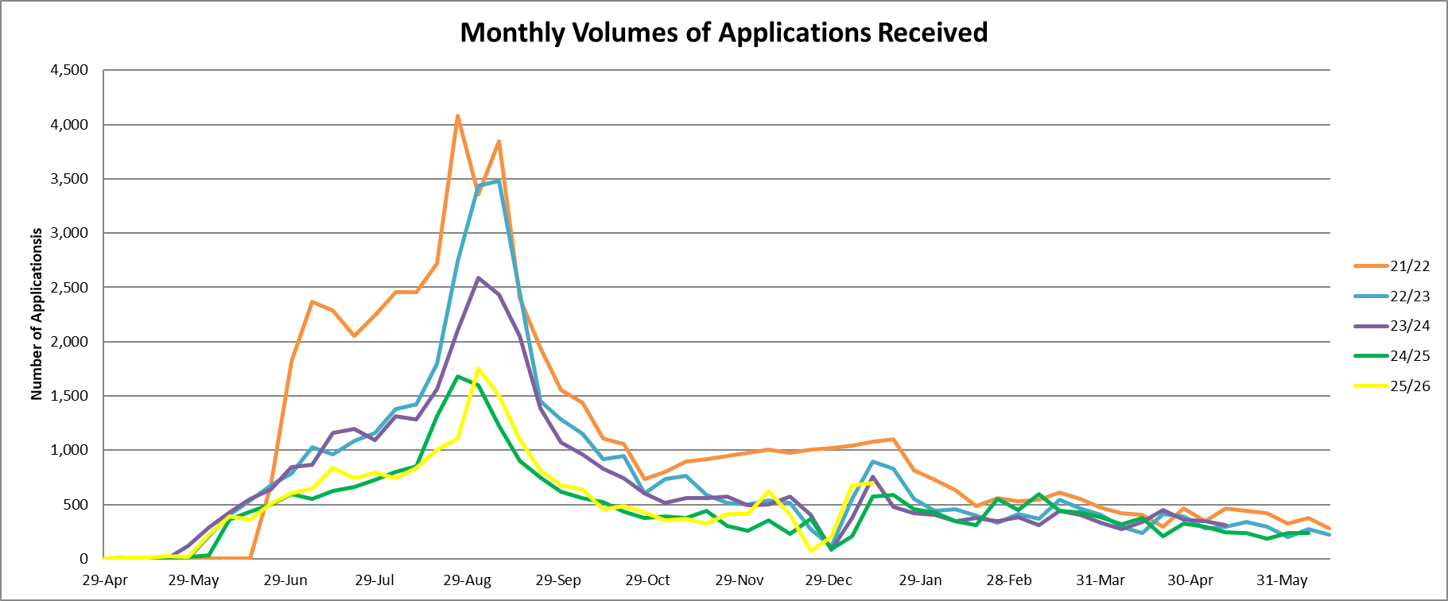
Application Submissions

Slide 11
Popular Learning Aims 25/26
Learning Aim Description | Learning Aim Level | Number of Applications | Number of LPs Offering Course
Diploma in Gym Instructing and Personal Training | Level 3 | 909 | 24
Diploma in Combined Beauty Therapy Skills (RQF) | Level 3 | 533 | 16
Diploma in Therapeutic Counselling (RQF) | Level 4 | 492 | 38
Diploma in Nail Technology | Level 3 | 475 | 29
Access to HE Diploma (Health Science Professions) | Level 3 | 398 | 27
Diploma in Supporting Teaching and Learning | Level 3 | 392 | 55
Diploma in Women's Hairdressing | Level 3 | 388 | 51
Access to HE Diploma (Health Professions) | Level 3 | 376 | 36
Diploma in Dog Grooming | Level 3 | 314 | 26
Foundation Diploma in Art and Design | Level 3 | 301 | 53
Diploma in Therapeutic Counselling | Level 4 | 293 | 19
Diploma in Nail Technology (RQF) | Level 3 | 251 | 10
Diploma in Make-Up Artistry | Level 3 | 229 | 16
Diploma in Business and Management (2023) | Level 3 | 227 | 5
Technical Specialist in Sports Massage Therapy (Diploma) | Level 3 | 219 | 15
Access to HE Diploma (Nursing and Midwifery) | Level 3 | 214 | 17
Access to HE Diploma (Healthcare Professions) | Level 3 | 201 | 12
Diploma in Beauty Therapy Treatments | Level 3 | 193 | 41
Diploma in Exercise Referral | Level 3 | 187 | 6
Diploma in Advanced Beauty Therapy | Level 4 | 171 | 20

Slide 12
Loan Facility
Managing Funding

Slide 13
Challenges / Things to consider
One performance management point (PMP) from 26/27– January
Growth and reductions calculated using a formula based on provider performance rather than through bidding or business case submissions
No growth awarded during PMP2
Forecasting and planning crucial:
If you want to be in scope for growth
If you want to maintain/increase loan facility contract for 27/28

Slide 14
Further Education
Funding Landscape

Slide 15
Lifelong Learning Entitlement
Non OfS Registered Providers:
ALL funding to remain for L4-6 until 29/30
Option to register – cost impact analysis
Option to become a franchisee
Exit L4-6 market from 30/31
OfS Registered Providers:
Level 3 provision funded via ALL
L4-6 provision funded via LLE for course start dates Jan 2027 onwards
Clear IAG required for mid year starts
Option to modularise with prior DfE agreement
Level 3 only from 30/31

Slide 16
OfS Registered Providers

Slide 17
Service Standards
Sector Performance

Slide 18
Service Standards
Process | Submission Accuracy | Elapse Time to Complete
Unique Learning Numbers | 99% | ULNs to be entered within 6 weeks of learning aim start date Where an application is received >4 weeks after learning aim start date, the ULN must be entered within 2 weeks of the application received date
Verification of Study Programme & Notification of Changes | 100% accuracy for approved applications before attendance confirmation | No timescale proposed. It is a condition of Attendance Confirmation that details are correct
Initial Attendance Confirmation | 99% | 85% learner attendance confirmations to be entered within 6 weeks of the learning aim start date if the application is approved Where an application is approved >4 weeks after the learning aim start date, the attendance confirmation must be provided within 2 weeks of the approval date
Subsequent Attendance Confirmations | 99% | 85% Learner attendance confirmations to be provided by payment drawdown date The payment drawdown date is the Thursday prior to the payment date (which is the 3rd Wednesday in the month)
Suspensions | 95% | 70% of suspension CoCs submitted within 60 days of notification AND 95% of suspension CoCs submitted within 90 days of notification
Withdrawals | 95% | 70% of withdrawal CoCs submitted within 60 days of notification AND 95% of withdrawal CoCs submitted within 90 days of notification

Slide 19
Attendance Management Guidance
Processes used to track, record and manage a learner's engagement, participation and attendance on their course, including enrolment, during study and on withdrawal or completion of the course
All providers should have Attendance Management policies and processes, whether formally documented or not
Student Finance Regulations rely on providers’ Attendance Management Policies to ensure timely and accurate administration of the Advanced Learner Loans

Slide 20
Attendance Management
‘Attendance on
a course means
active and
on-going engagement’
How is ongoing engagement measured?
Submission of assignments/work on student record/dashboard?
Appointments with Tutors?
Online registers for lectures?
Use and record Swipe Card activity on campus?
How is information shared with administration staff responsible for the portal?

Slide 21
Academic Year Preparation
2026/27

Slide 22
Milestones
Timeline
Publication of DfE Funding & Performance Rules
Application Launch for ALL (TBC)
PMP2 outcomes applied
PMP outcomes applied
March 26
April 26
May 26
June 26
Jan 27
March 2027
April – July 27
Learner applications
Proposed PMP deadline
26/27 contracts issued
LAFIL template published
Max loan rates published
Learning Aims approved for funding

Slide 23
Useful Contacts and Resources
Partners’ Support Desk
lpservices@slc.co.uk / 0300 100 0643
Practitioner Support
SSIN_Queries@slc.co.uk / 0300 100 0618
For detailed information regarding policy, regulations, eligibility or circumstantial questions
Practitioners’ Website
https://www.practitioners.slc.co.uk/supporting-materials/

Slide 24

FE Account Management Team
lpservices@slc.co.uk
www.gov.uk/slc

