Slide 1
Learning Provider Training Event
FE Account Managers
Partner Services
May 2025

Slide 2
Advanced Learner Loans
Roles & Responsibilities

Slide 3

Knowledge Check
Who is responsible for ……. | DfE | SLC | LP
Making payments to learning provider
Issuing loans contracts
Determining the maximum loan amounts
Monitoring performance on advanced learner loans
Setting the funding rules
Setting the fees policy
Setting bursary criteria

Slide 4
Department for Education
Policy intent
Student Loans Company
Loan application process
Learning Providers
IAG
Entitlement checks
Fees Policy
Issue LAFIL
ILR and Audit
Designating qualifications Provider and agreement management
Market entry/exit
ALL Bursary payments
Funding Rules
Allocations
Performance Monitoring
Assurance Audits
Investigations
Loan facility payments via the provider portal
Provider service level agreements, including confirmation and change
HMRC repayment process
Events programme
Account management
Monitoring of service standards compliance
LP portal and service compliance
Manage funding allocation

Slide 5
Advanced Learner Loans
Learner Application

Slide 6

Key Facts
Approved Learning Aim
Meet Residency Criteria (UK, EU or RoW)
Up to 4 loan entitlements (exceptions apply)
Repeat and concurrent study allowed
Min loan £300,max determined by DfE cap
Loan payable over maximum duration
Application deadline
Delivered in England
Notes:
A Levels and A2HE Dips – paid over max of 2 years
Level 3-6 tech/general quals – paid over max 3 years

Slide 7
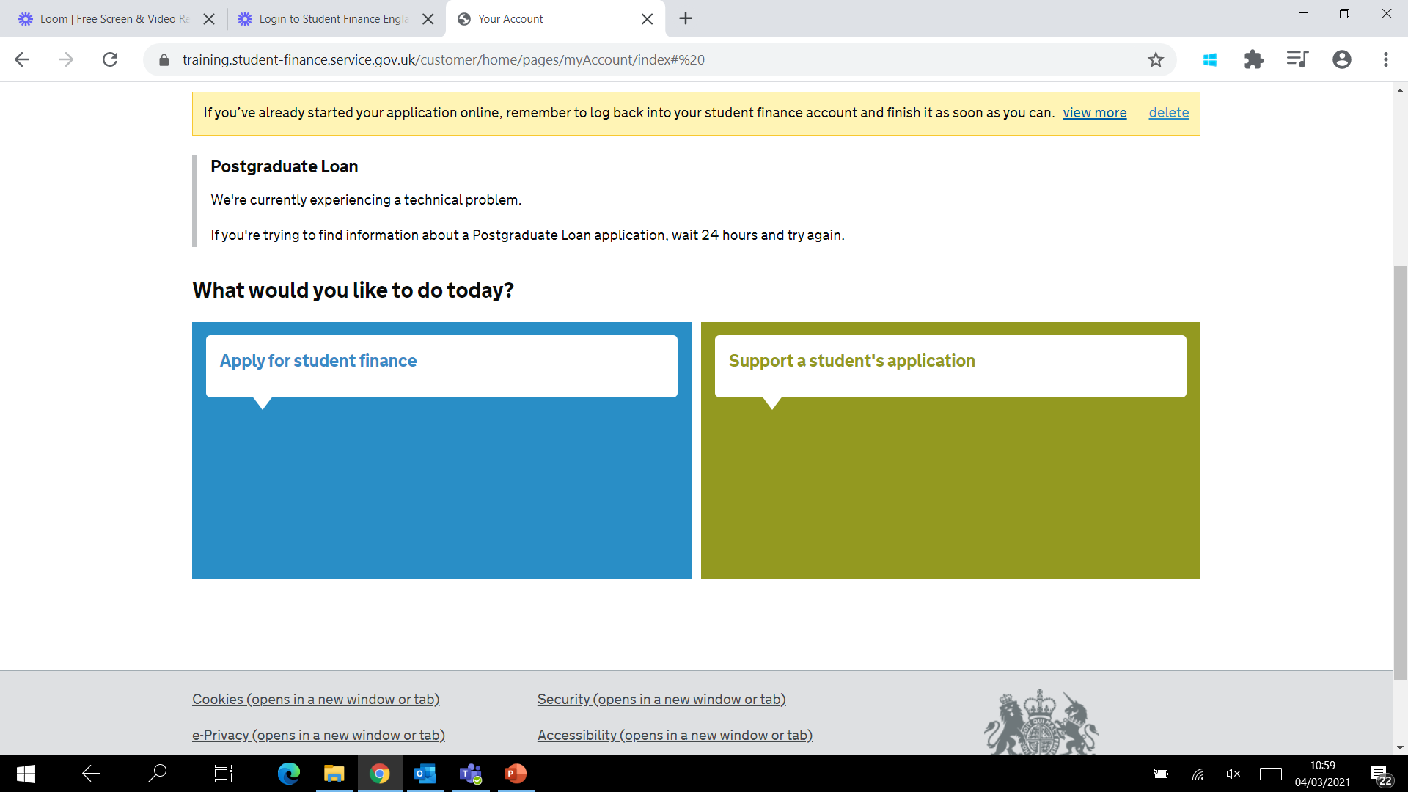
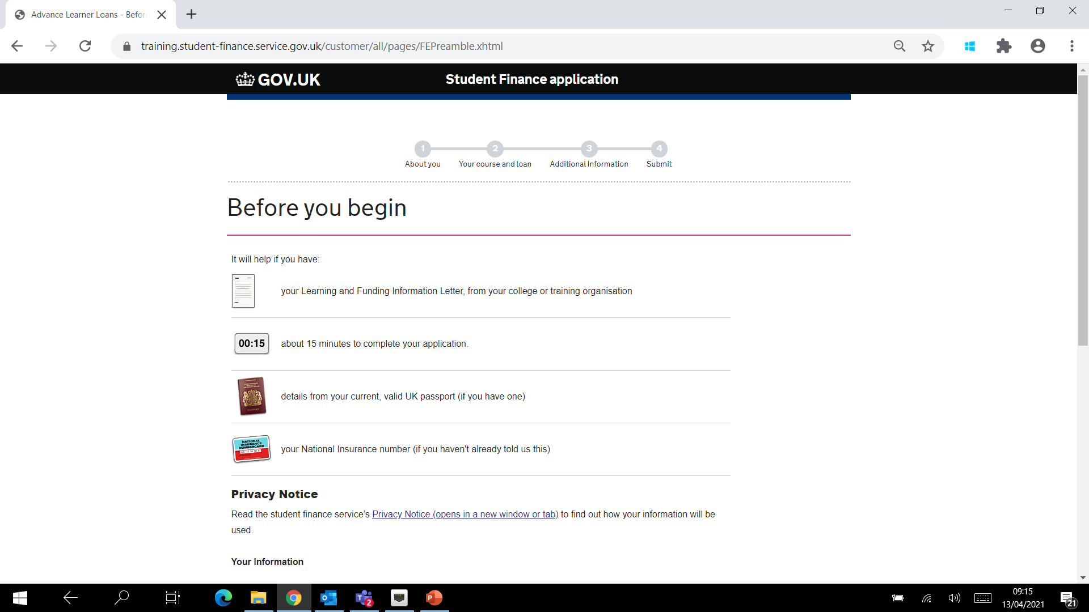
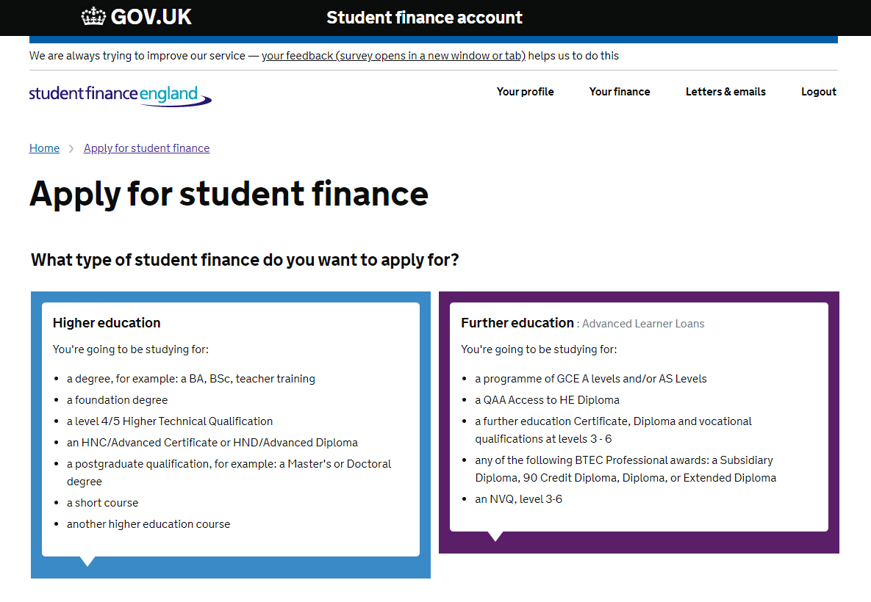

Slide 8
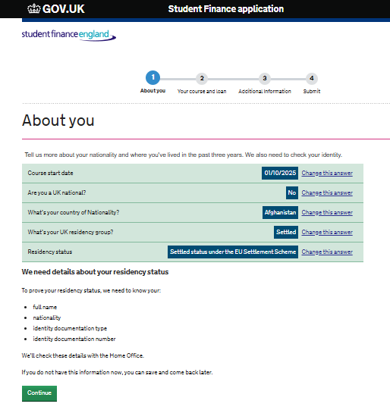
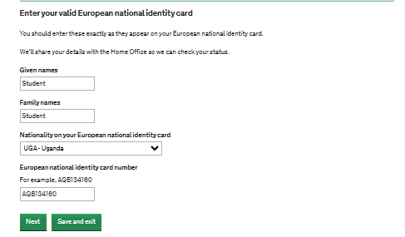
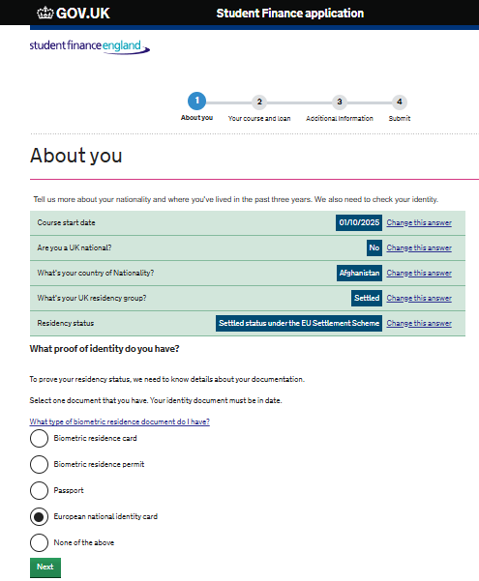
A new category will soon be added to the list of biometric documents which is called the UKVI Customer Number
Notes:
Please note a new residency document is being added soon which is called the UKVI Customer Number. These document details will persist to the passport field on the Ops Portal. Date being released to Production TBC

Slide 9
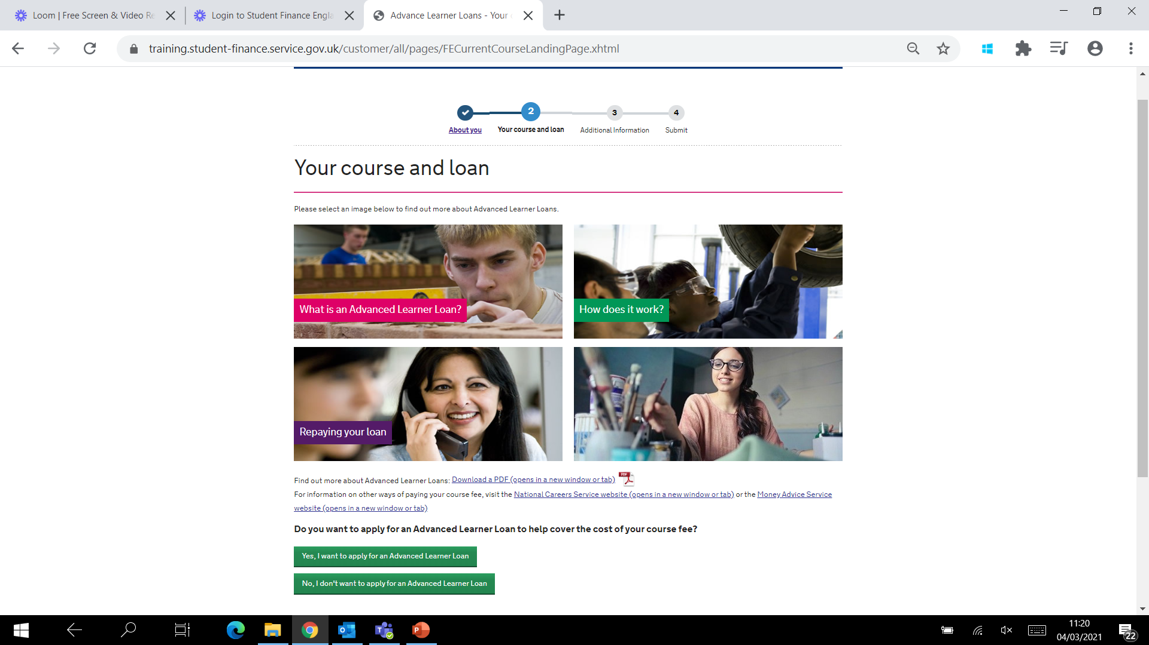
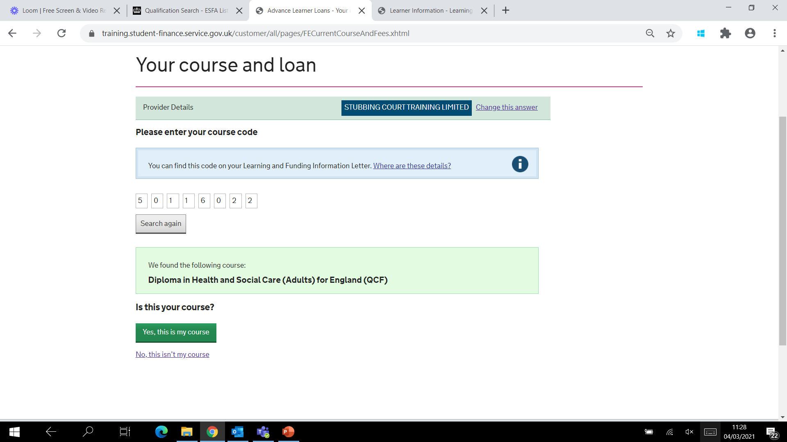

Slide 10
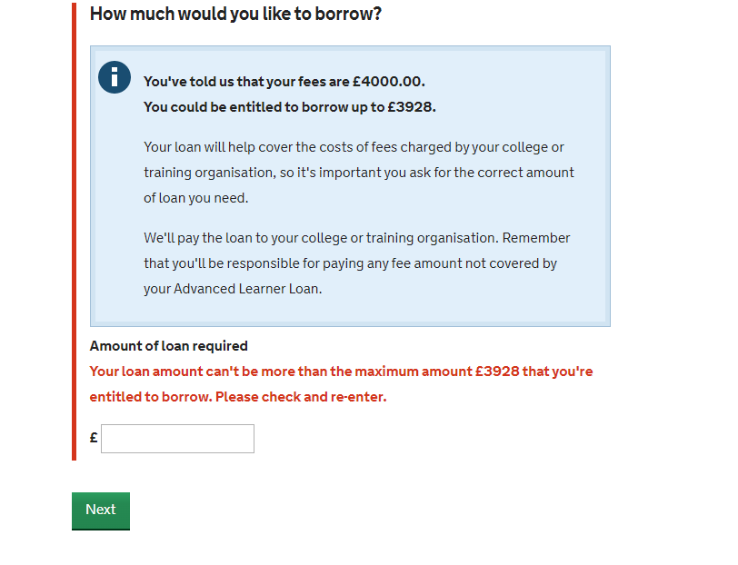
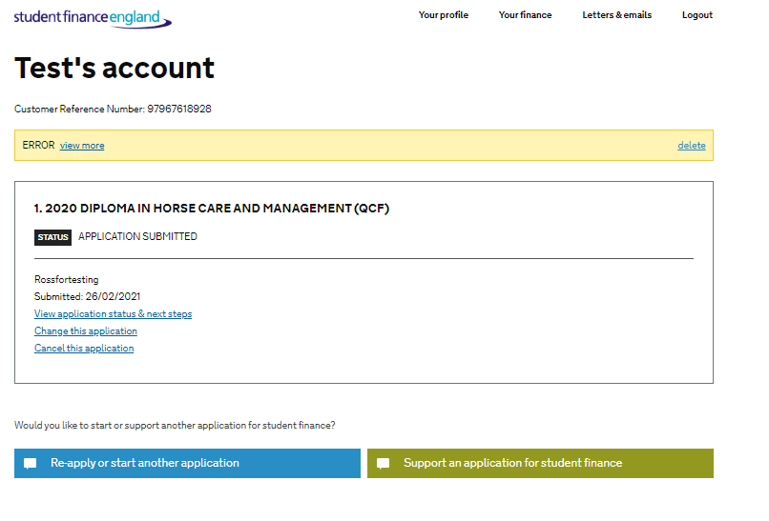
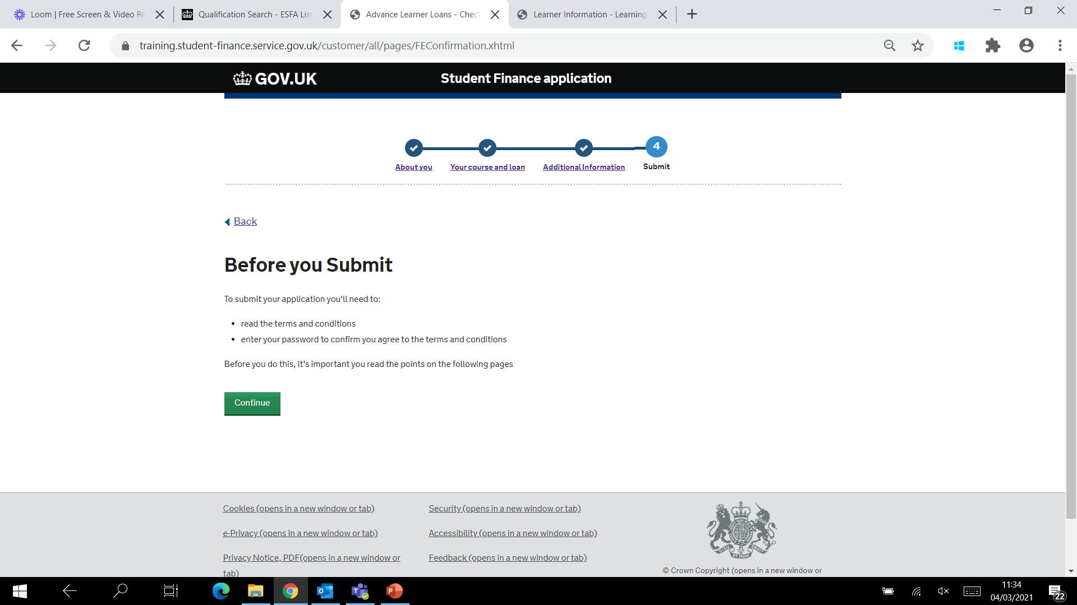

Slide 11
Third Parties
Department for Education
HM Passport Office
Home Office
Department for Work & Pensions
Notes:
LP must have contract and funding available before application can be progressed
UK ID – can now accept photocopies of birth/adoption certs.
We may want to talk about how Operations support us ahead of PMP points to prioritise ALL applications for LPs approaching criteria % point
HODS includes RoW and EUSS learners. Document number used to verify ID/residency status via HODS check. If this does not provide sufficient information, we send for a full SVEC check.

Slide 12

Auto Cancellations
Owner | Action | Timeframe
Learner | Auto-cancelled In Data Entry | 30 days
Learner | Auto-cancelled Missing Evidence | 45 days
Learner | Auto-cancelled Eligibility Incomplete | 45 days
Learners are informed that we may cancel their application if they do not return the evidence
We will not issue correspondence for automatically cancelled applications
The application will be reinstated if we receive evidence after it has been cancelled

Slide 13

Application made Ineligible
Joe’s application has been made ineligible - not due to personal eligibility
Discuss possible reasons why this may have occurred
Loan duration less than 2 weeks
Loan requested less than £300
Application service not yet launched
ALL contract signed / returned / visible on Loan Facility Details report
Auto restriction / reduction applied
Learning aim is no longer designated for funding
Maximum 4 loans taken
Second Access to HE application

Slide 14
Repayment Key Facts
Advanced Learner Loans not subject to credit checks and will not appear on credit files
Some lenders may ask about loans as part of affordability checks
Repayment threshold - £25k a year gross (Plan 5)
Repayment calculated at 9% of income over £25,000
Learners move into repayment in the April after they complete/leave their course
Interest applied from day first payment made until repaid in full or cancelled
Income each year before tax | 9% will be deducted from | Monthly Repayment (Approx)
£25,000 | £0 | £0
£27,000 | £2,000 | £15
£30,000 | £5,000 | £37
£35,000 | £10,000 | £75
£40,000 | £15,000 | £112
Notes:
Students won’t make repayments until their future income is over £25,000 a year (gross) or the weekly (£480) or monthly (£2,083) equivalent
Current interest rate 4.3%

Slide 15
Advanced Learner Loans
Getting Ready for 2025/26

Slide 16





DfE Timelines
Loan cap remains unchanged
Sign 25/26 contract
DfE Funding Rules & LAFIL published April
2 Performance Management Points - Oct and Jan
Criteria for growth set out in Funding Rules
Notes:
25/26 loan caps to remain frozen
Contracts issues Spring – sign ahead of launch and ensure visible on LFD
Funding rules– no policy changes. The performance management rules will be included, October and January review points will remain
Exception case form
SLC provide recommendations based on LP compliance against SMF
Delay issue of LAFIL until service launch – SAVE FOR SLIDE 20

Slide 17
Learning & Funding Information Letter – Things to Consider
What extra information / links might you include in yours?
When do you issue them?
What checks are done prior to issue?
Issue a revised LAFIL if there is a change to the tuition fee and/or learning aim
Notes:
Each table will have a LAFIL template to review and discuss (5 mins)
What do they include in theirs?
When do they issue them?
What checks are done prior to issue?

Slide 18
Academic Year Readiness
Contracts Manager to digitally sign and return 25/26 loan facility contract promptly
Ensure 25/26 loan facility is visible on LP Portal ahead of application service launch
Ensure LAFILs are not issued ahead of launch to avoid applications being made ineligible
Review Contacts and User list ahead of new academic year
Be mindful of processing times, especially during ‘peak’ times

Slide 19
Advanced Learner Loans
What To Do & When

Slide 20
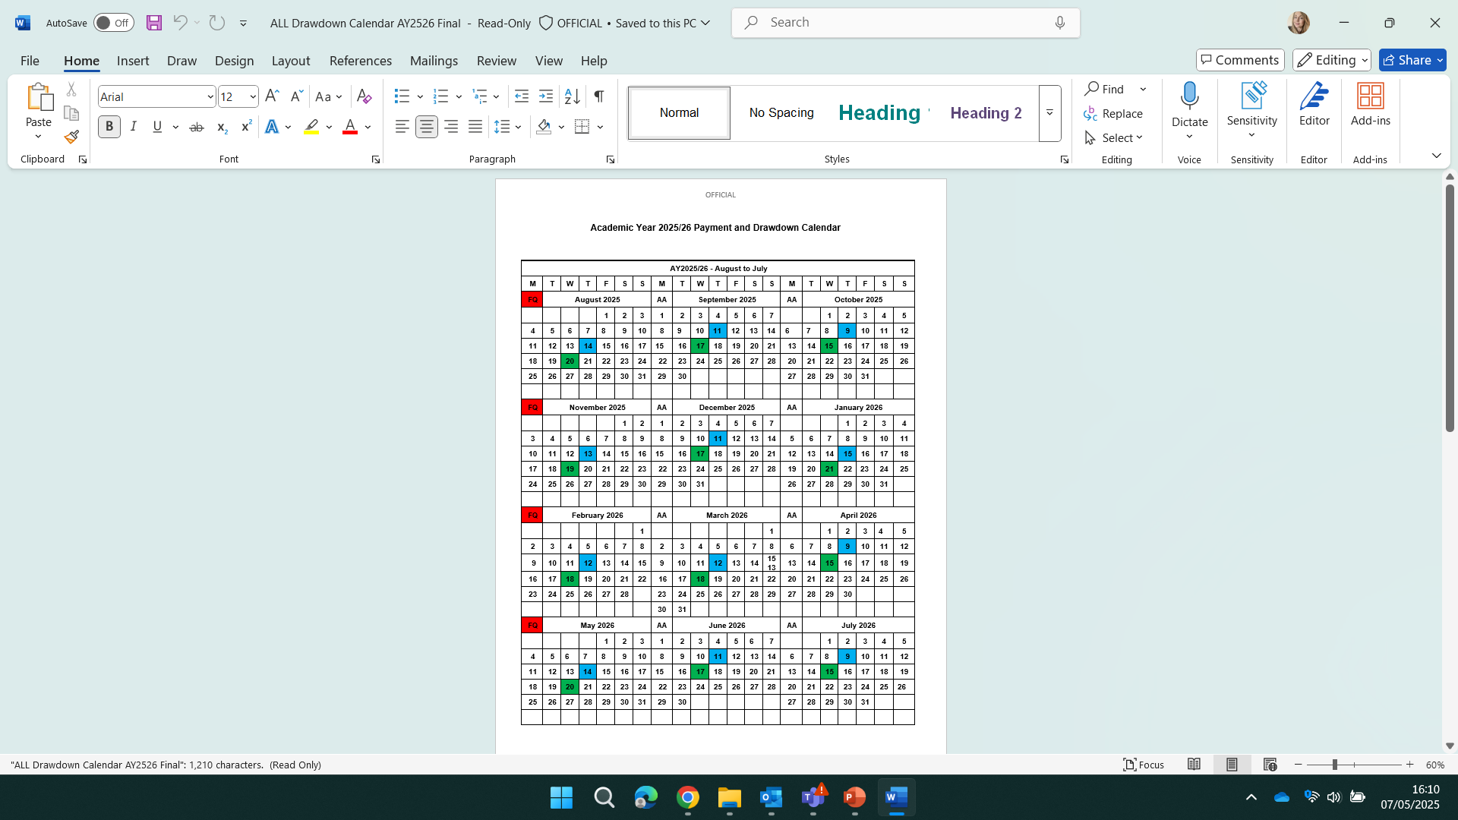
Pre-Liability
Verification of study programme
ULN Entry
Initial confirmation
Fixed Quarters
Post Liability
Attendance
Suspensions
Withdrawals

Slide 21
Service Standards
Process | Submission Accuracy | Time to Complete
Adding Unique Learner Numbers | 99% | ULNs to be entered within 6 weeks of the learning aim start date. Where an application is received more than 4 weeks after the learning aim start date, the ULN must be entered within 2 weeks of the application received date
Check information (e.g. Fee Charged, Learning Aim, Start Date etc) and make any necessary changes | 100% accuracy for approved applications before initial and subsequent attendance confirmations | No timescale proposed. It is a condition of Attendance Confirmation that details are correct
Initial Attendance Confirmation | 99% | Attendance confirmation to be entered within 6 weeks of the learning aim start date if the application is approved. Where an application is approved more than 4 weeks after the learning aim start date, the attendance confirmation must be provided within 2 weeks of the approval date
Subsequent Attendance Confirmations | 99% | 85% of learner attendance confirmations to be provided by payment drawdown date AND 99% of learner attendance confirmations to be provided within 60 days of payment drawdown date
Suspensions | 99% | 60% of suspension COCs submitted within 60 days of notification AND 99% of suspension COCs submitted within 90 days of notification
Withdrawals | 99% | 60% of withdrawal COCs submitted within 60 days of notification AND 99% of withdrawal COCs submitted within 90 days of notification
Notes:
Form part of the DfE’s performance and funding rules
Highlight the focus is also now on accuracy - As part of the service standards, it’s important you meet not only the timescales set out against each standard, but also the submission accuracy. We refer to this as getting it ‘Right First Time’.
If you ever have a large volume of accuracy errors AM will be in touch.

Slide 22
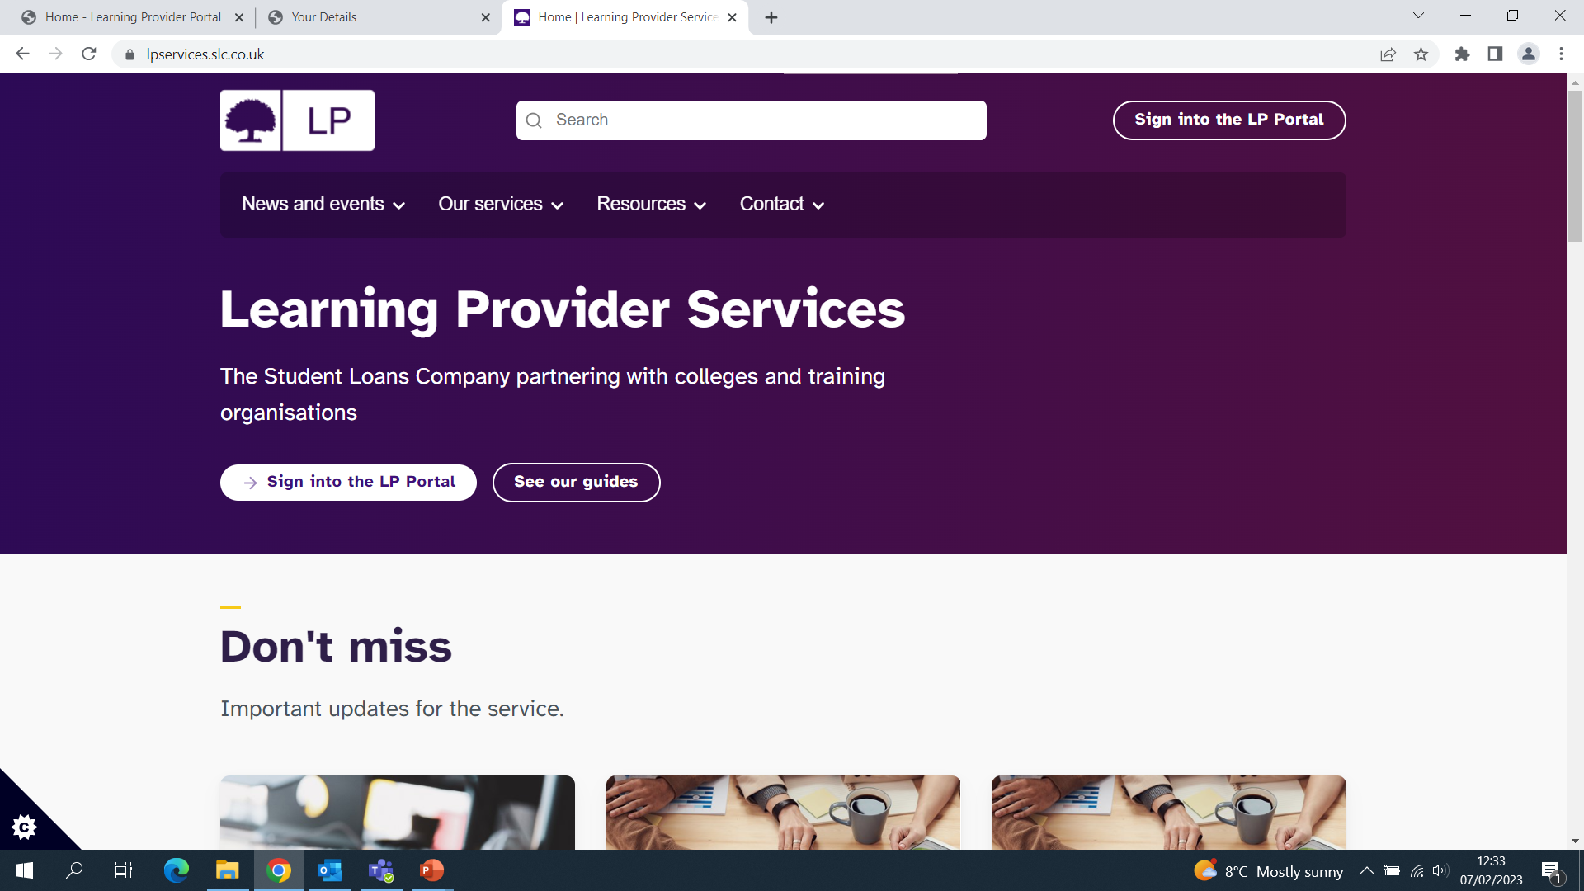
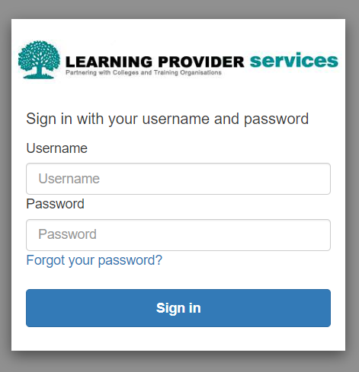
LP Portal Login via LP Services website
Pay
Loans and grants
Tuition fees
Bursaries
Notes:
DEMO – Housekeeping, check contacts list, user access, profile section up to date etc
Also demo learner search screen and parameters you can us to retrieve learners/information
Navigate to LPS to show guidance, news, events etc.

Slide 23
Advanced Learner Loans
Pre Liability Stage

Slide 24
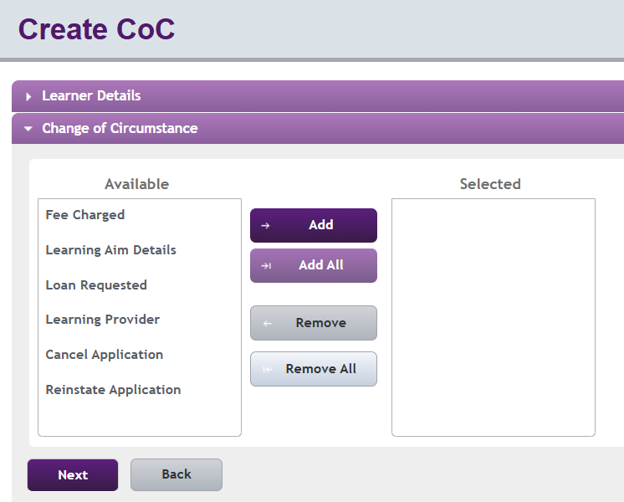
Pre-Liability Changes
The types of changes that can be made at this stage:
Change of fee charged
Change of loan amount requested (decrease only)
Change of learning aim details
Change of learning provider
Cancellation
Re-instatement (if the application is cancelled)

Slide 25
Auto Cancellation
Stage | Action | Timeframe
Pre Liability | Cancelled: Auto Missing ULN | 90 days
Pre Liability | Cancelled: Auto Approved | 90 days
You have 60 days to reinstate an application once it has been cancelled
If a learner is a non-starter or does not attend past 2 weeks, you can cancel
Notes:
DEMO –
CHECK MISSING ULN HYPERLINKS,
CRN 09861264541 CLAIRE BENNETT – add ULN 8721074940 then add course location (up to 8 alphanumerical)
CRN 29861262701 ZACK LITCH - change start date via Learning Aim Details
4. CoC Home – changes for multiple learners CHANGE LA REF AND FEE AMOUNT – IMPORTANT TO DO BOTH AS FEE DOES NOT AUTO UPDATE Search LA Ref: 60060487 – change to 50092868 fee amount £811 - effective from today’s date
HIGHLIGHT THAT EFFECTIVE DATE NEEDS TO REFLECT WHEN THE CHANGE OCURRED; NO NEED TO TAKE BACK TO START DATE OF COURSE

Slide 26
Incorrect Start Date
False Start
Missing Attendance
An application is at Missing Evidence. The learner has entered the wrong start date which the provider has noticed.
The provider tries to amend the date but is unable to.
Why is this?
Provider is only to make changes once application moves to approved
Provider cancels a learner’s application as they were a non-starter.
The learner subsequently wants to start the course.
What will they need to do?
Provider can reinstate the application if it was cancelled within 60 days. Ensure start date is within same academic year
A learner’s application has moved to approved.
They are not on the attendance work list for confirmation.
Why do you think this is?
Either the ULN has not been added, or the initial liability point has not elapsed
Notes:
Group chat and summary

Slide 27
Advanced Learner Loans
Confirming Attendance

Slide 28
Initial Attendance
Subsequent Attendance
Learner populates on worklist 2 weeks after the course start date
Initial attendance must be confirmed within 6 weeks of the course start date
Initial attendances colour coded green on worklist
Marking a learner as ‘not in attendance’ at the initial stage will cancel the application
Application will be auto cancelled if attendance not confirmed within 90 days
Once initial attendance confirmed, attendance required at each quarter
Active learners will populate on the worklist on these dates:
1 Aug - 1 Nov - 1 Feb - 1 May
Attendance must be confirmed by the drawdown date
Attendance is assumed on months in between fixed quarters
Application will be auto withdrawn if attendance not confirmed within 12 months
Notes:
DEMO a/c list and colour coding also CoC work list

Slide 29
Course Dates: 11/09/25 – 06/07/2026
What learner information should you check before confirming attendance?
When would an initial attendance confirmation be available?
Which months are subsequent attendance confirmations due?
When would you expect the first payment to be made?
Learner and Learning
Aim information is accurate
25/09/25
November February
May
15/10/25
Notes:
CAN WE HAVE DRAWDOWN CALENDAR ON EACH TABLE (PERHAPS ONE EACH?) AND ASK THEM TO DISCUSS IF TIME PERMITS.

Slide 30

Internal processes
Student Finance regulations rely on providers’ internal policies to ensure timely and accurate administration of Advanced Learner Loans
They should define how to track, record and manage a learner's engagement, participation and attendance on their course.
All providers should have processes either formally documented or not
Notes:
Attendance means participation on a course, including teaching face-to-face or blended study. Should cover enrolment process, during study and on withdrawal or completion of the course.
Providers should communicate their policy to learners and have an auditable process in place.
Providers should ensure the demands of the course and any personal circumstances of learners are considered.
If a learner’s participation in a course does not meet the Provider’s expectations, SLC should be informed promptly that the learner has withdrawn.

Slide 31
Points to Consider
You may want to discuss your internal processes with the wider organisation and consider what changes could be made to ensure they align to the service standards…
Do you have a documented policy? How is it made accessible to learners?
Do you have trigger/intervention points?
What challenges might you encounter to ensure you receive accurate information about learner participation?
Notes:
College managers must implement a method to ensure that the learner understands and formally agrees to the policy as part of their learning agreement, prior to starting their programme/course.

Slide 32
Advanced Learner Loans
Post Liability

Slide 33
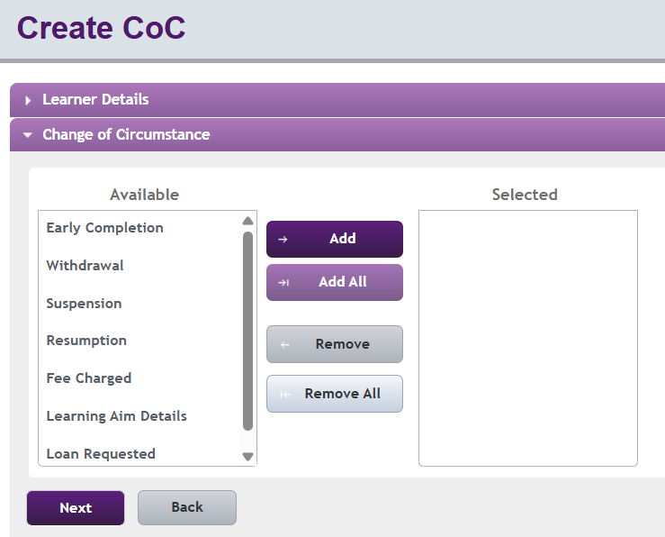
Post-Liability Changes
  Changes that can be made are:
  Change of fee charged
  Change of loan amount requested (decrease only)
  Change of learning aim details
  x Change of learning provider
  x Cancellation
  x Re-instatement (if the application is cancelled)
  You can now also submit the following changes:
  Early completion
  Suspension
  Resumption
  Withdrawal
Notes:
GO TO PORTAL FOR DEMO
Process Cocs as follows –
Suspension – CRN 89861264561 Rachel Best– date of suspension 30/04/2025 but show that the portal will not accept a date prior to the initial attendance date
Withdrawal – CRN 69861263671 Morty Long – date of withdrawal 02/05/2025 – loan due to May as attended for some of the month

Slide 34
Post Liability
You cannot increase fee amount after course end date
You cannot change start date once initial attendance confirmed
Once the end date has passed it cannot be amended
Changes to the learning aim must be at the same level and type
You cannot alter ‘in attendance’ confirmation after draw down

Slide 35
Troubleshooting
Post Liability
Level 3 entitlement – zero fee and leave at approved if attendance already confirmed
Fee amount - at provider discretion if they charge above the loans cap in place
Resumption – remember to push out end date if required at time of resumption
Early Completion - Effective date cannot be before a confirmed attendance at a fixed quarter
Mid course learning aims changes - ensure same level and type and new course eligible from start date
Auto withdrawal - 12 months if application not resumed or withdrawn
Notes:
Fee adjustments – if LP wishes to reduce loan liability below amount due up to withdrawal date, we will need to manipulate fee amount in the background.
Change learning aim reference
Consider new fee
Bear in mind new learning aim will have to have been eligible from start date of course
Issue new LAFIL and add to learner file

Slide 36
Advanced Learner Loans
Managing Your Loan Facility

Slide 37
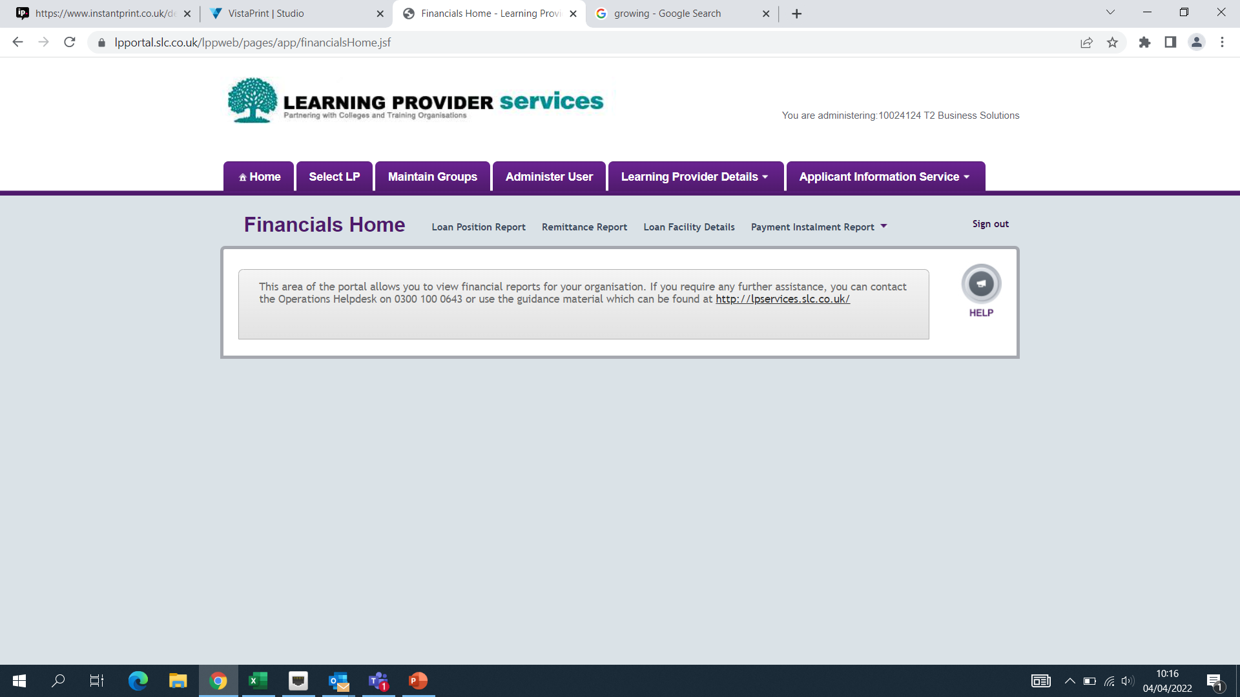
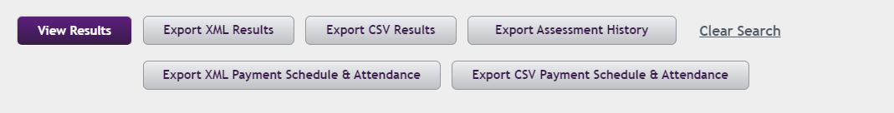
Financial Reports
Notes:
GO TO PORTAL FOR DEMO
DEMO LFD / PIR / PAYMENT SCHEDULE & ATTENDANCE REPORT - RECONCILE

Slide 38
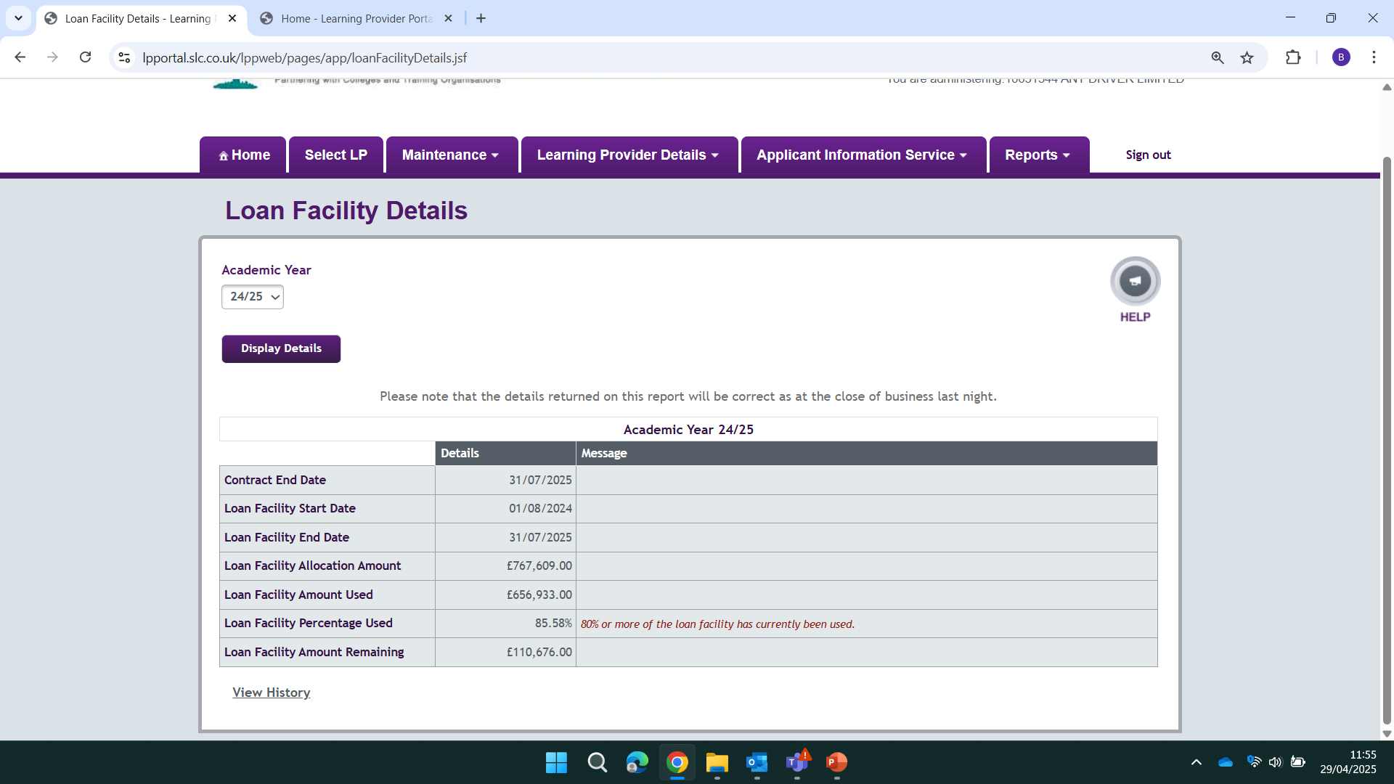
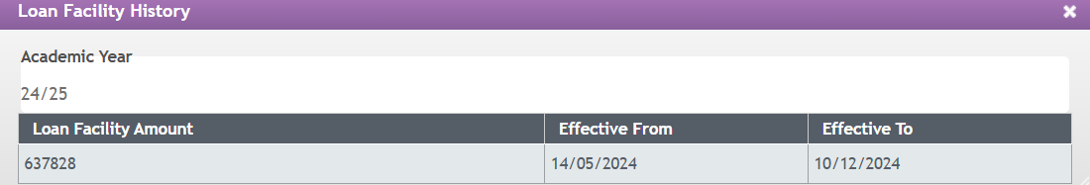
Loan Facility Details
Notes:
GO TO PORTAL FOR DEMO
DEMO LFD / PIR / PAYMENT SCHEDULE & ATTENDANCE REPORT - RECONCILE

Slide 39
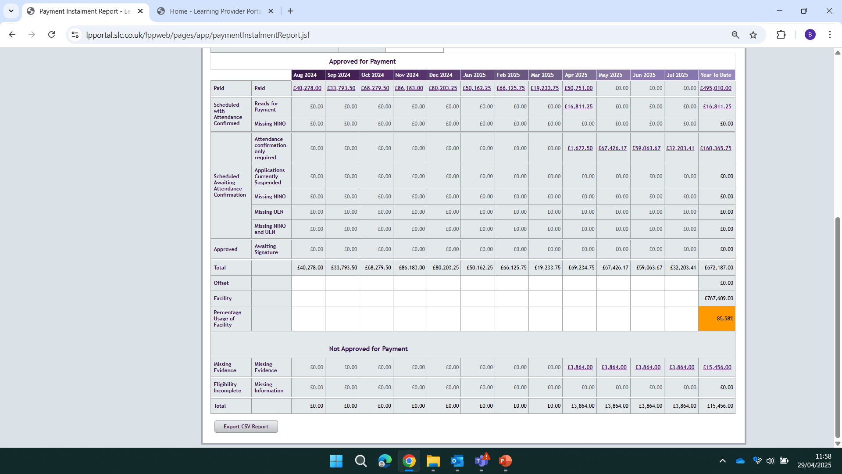
Payment Instalment Report
Notes:
GO TO PORTAL FOR DEMO
DEMO LFD / PIR / PAYMENT SCHEDULE & ATTENDANCE REPORT - RECONCILE

Slide 40
Monitoring your Facility
Learning & Funding Information Letter
Start / End Dates
Scheduled Payments
Financial Reports
Loan Facility Details
Payment Instalment Report
Performance Management Points
Exception Case Form
Approved / Suspended included in amount ‘used’
Growth notification to portal upload
Notes:
LAFIL available on gov.uk at the end of April monitor LAFILS
Approach any points in the year to focus on? Enrolments dates, PMP points, curriculum planning mid year
Useful reports – LPR and exports to identify learner status. LFD tracks scheduled payments. DOES ANYONE STILL USE LOAN POSITION REPORT?
Work with SLC and ESFA to ensure SMF/funding rules compliance. Good relationship with ESFA TM and SLC FE AM.
Be mindful that reductions are also applied at PMP2 –
Challenge of PMP1 award going live December / lag in award – how do you ‘use’ it effectively?

Slide 41

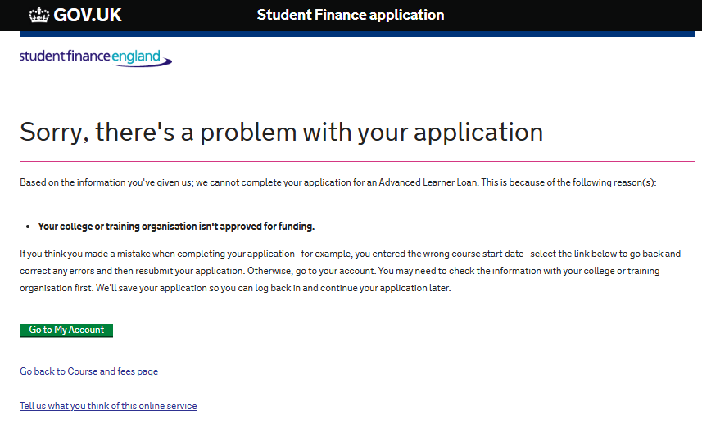
Loan Facility Details
Loan Facility Percentage Used | Message on LP Portal | Email Generated
80% | ✓ | ×
90% | × | ✓
100% | ✓ | ✓
Current message on customer portal if learner tries to apply but provider has used100% of their loan facility

Slide 42
Financial Reporting
Drawdown Date
Thursday prior to the payment date
Payment Date
Payment made if attendance confirmed by the COB on draw down date
Always the third Wednesday of the month
No interim or catch-up payments throughout the month
Financial Reports
Payment Instalment Report and Remittance Report available to view and export the Friday after the draw

Slide 43


Monitoring Your Facility
Course 12 July 2024 – 09 July 2025
Auto restriction applied to 23/24 as reached 100%
The learner will be made ineligible?
Notes:
clearly outlining the triggers, steps and actions for a learner withdrawal

Slide 44
Maximising Your Facility
Course start date 17 July 2024
First payments scheduled for 31 July
First payments made August
The full loan amount will be allocated against 2025/26 loan facility
Notes:
Payments will be made in August as draw down date passed
However, payments scheduled for July will be allocated against 22/23 loan facility usage

Slide 45
Overpayments
Where an overpayment is made, SLC will claw this back from future payments
SLC will offset this overpayment against the next payment made to the provider
Therefore, the provider will receive their monthly payment minus any overpayment

Slide 46
Best Practice
Work towards the monthly draw down date to ensure compliance - narrow window some months
Initial attendances due within six weeks of course start date – end date can be pushed out or application cancelled
Ensure ‘Not In Attendance’ confirmations are followed up with the appropriate CoC - check CoC Worklist
Consider when and how to use suspensions
Drive down suspensions and withdrawals - 90 to 60 days
Review your attendance management policy – does it align to the service standards?

Slide 47
Advanced Learner Loans
Information, Advice & Guidance

Slide 48
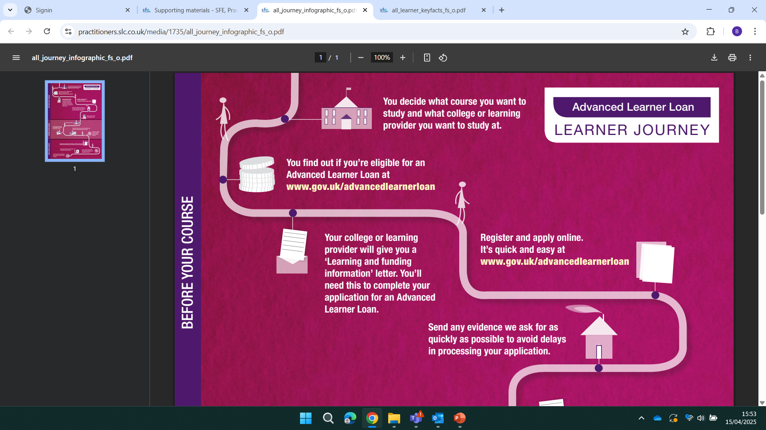
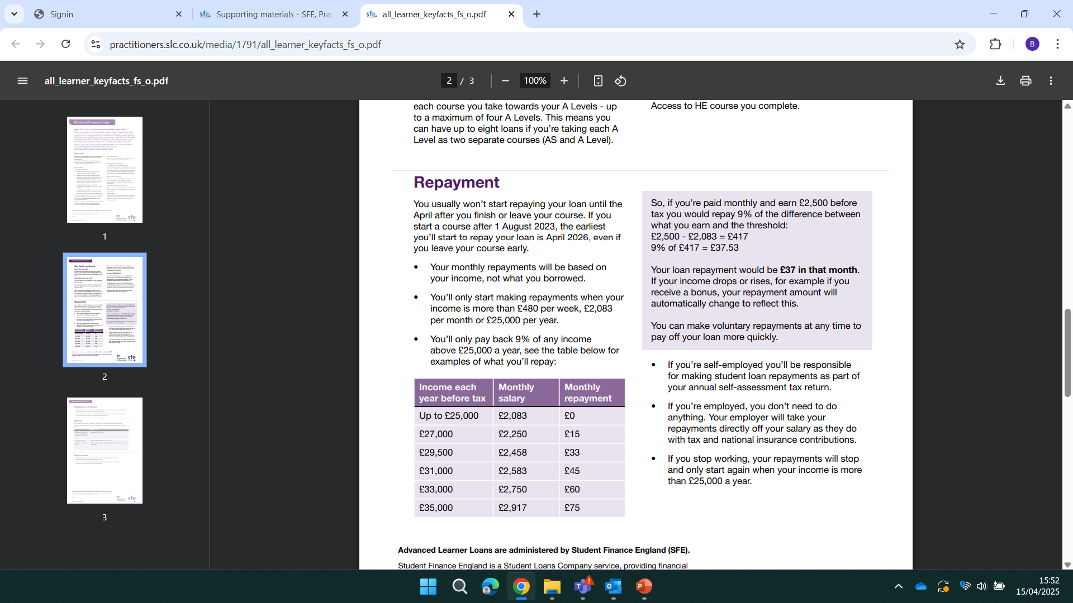
Information sources
Learner’s FAQs
Learner’s Key Facts
Infographic Poster
Repayment Quick Guide
What other materials would work well?
https://www.practitioners.slc.co.uk/

Slide 49
Further Support & Resources
Partners’ Support Desk
lpservices@slc.co.uk / 0300 100 0643
Practitioner Support
SSIN_Queries@slc.co.uk / 0300 100 0618
For detailed information regarding policy, regulations, eligibility or circumstantial questions
LLE Provider Preparation Guide
https://www.heinfo.slc.co.uk/lle/lle-resources/
Practitioners’ Website
https://www.practitioners.slc.co.uk/supporting-materials/
DfE Funding Rules 2025/26
https://www.gov.uk/government/publications/advanced-learner-loans-funding-and-performance-management-rules/advanced-learner-loans-funding-and-performance-management-rules-2025-to-2026
Notes:
clearly outlining the triggers, steps and actions for a learner withdrawal

Slide 50

Lifelong Learning Entitlement - 2025
Provider Preparation Guide published – Feb 2025
DfE announcement due June 2025. Should include:
  The regulation of providers under LLE with OfS
  Maintenance loans
  Supplementary grants
  Priority courses and additional entitlement
  Information on the expansion and regulation of modular funding with the OfS
SLC IAG Webinars – July / August 2025
SLC Seminars – November 2025

Slide 51

Learning Provider Regional Forums
LP_Services@slc.co.uk
www.gov.uk/slc

