Slide 1

Learning provider training
Advanced Learner Loans (ALL)
FE Account Managers
Partner services
2026

Slide 2
Agenda
Roles and responsibilities
Learner application process
SLC service standards
Navigating the LP Portal
Financial reporting
Learner repayment process
Preparing for academic year (AY) 2026/27
FE sector updates

Slide 3
Roles and responsibilities

Slide 4
Knowledge check
Who is responsible for… | SLC | DfE | Provider
Making payments to provider
Issuing loans contracts
Determining the max loan cap
Monitoring ALL performance
Issuing LAFIL
Setting fee policy
Bursary criteria
Setting the funding rules

Slide 5
Roles and responsibilities
Student Loans Company
Department for Education
Learning Provider
Learner application and assessment
Customer contact
Payment and repayment
Managing provider relationships
Monitoring service standard compliance
Work with DfE to implement policy
Overall responsibility for the loans policy
Oversee effective and efficient loans system
Programme funding
Managing LP ALL contracts
Funding performance management rules
Course eligibility
Max loan cap
Provider growth process
Set fee policy
Issue accurate LAFIL to learners
Make sure courses are funded
Monitor and manage loan facility allocation
Comply with service standards and DfE funding rules
ILR submissions – make sure data matches

Slide 6
Learner eligibility and application

Slide 7
Checking eligibility
Passport check
Yes
UK nationals
Valid, in-date passport?
No
Birth certificate
DWP – National Insurance number verification
Home Office data share
Rest of the world
Document number
Manual check

Slide 8
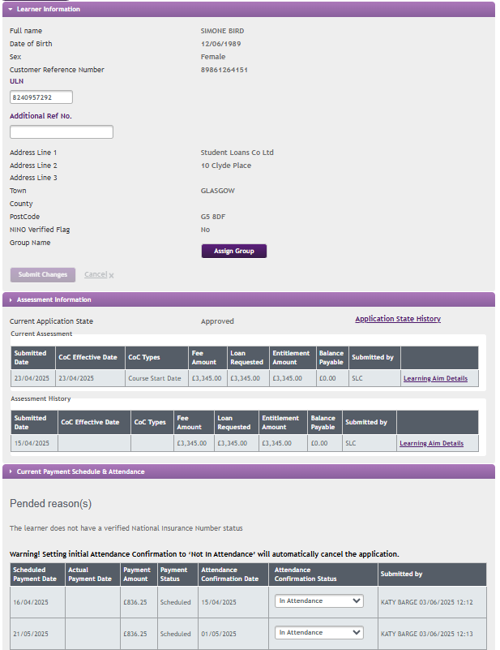
In this example, the National Insurance number has not yet been verified
You can confirm attendance but we will not release payment until it is verified
The process should take no more than 2 weeks

Slide 9
Good to know
Learner important facts
A learner can apply for a minimum loan of £300
Learners can apply for 2 loans for eligible courses running at the same time
Only one application required for the full duration of the course
Learners can submit their application up to the last day of their course
Learners can apply for up to four loans*
Learners can get repeat funding for a course if required*
Learners can amend certain information by logging into their account
*Access to HE and A Levels are the exception

Slide 10
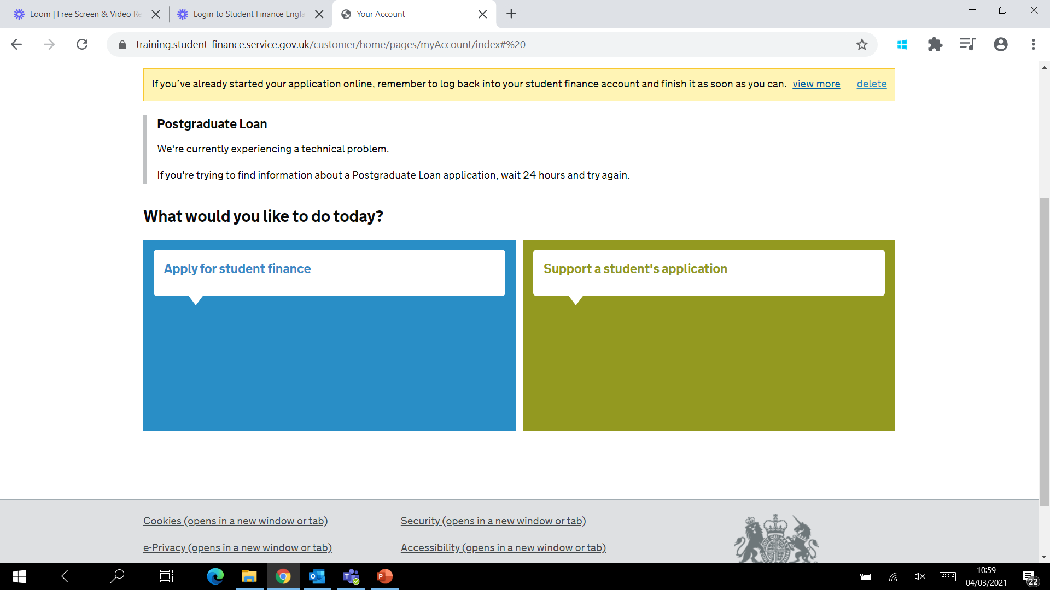
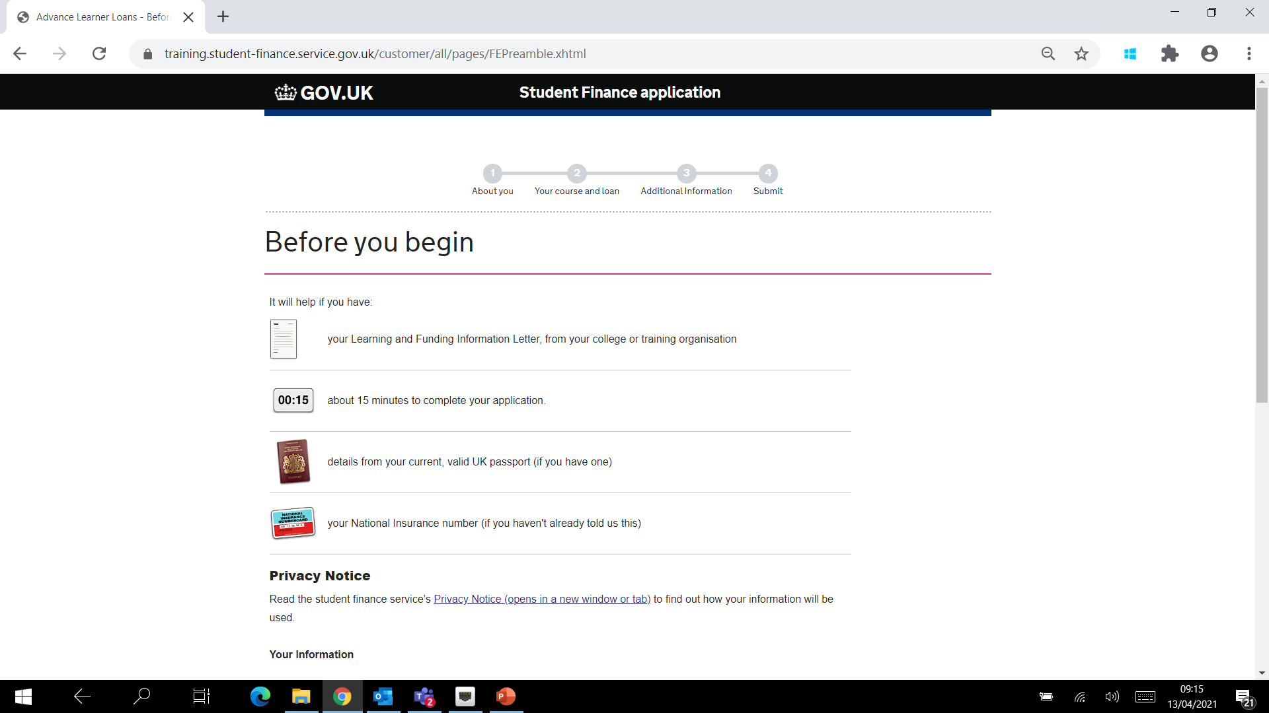
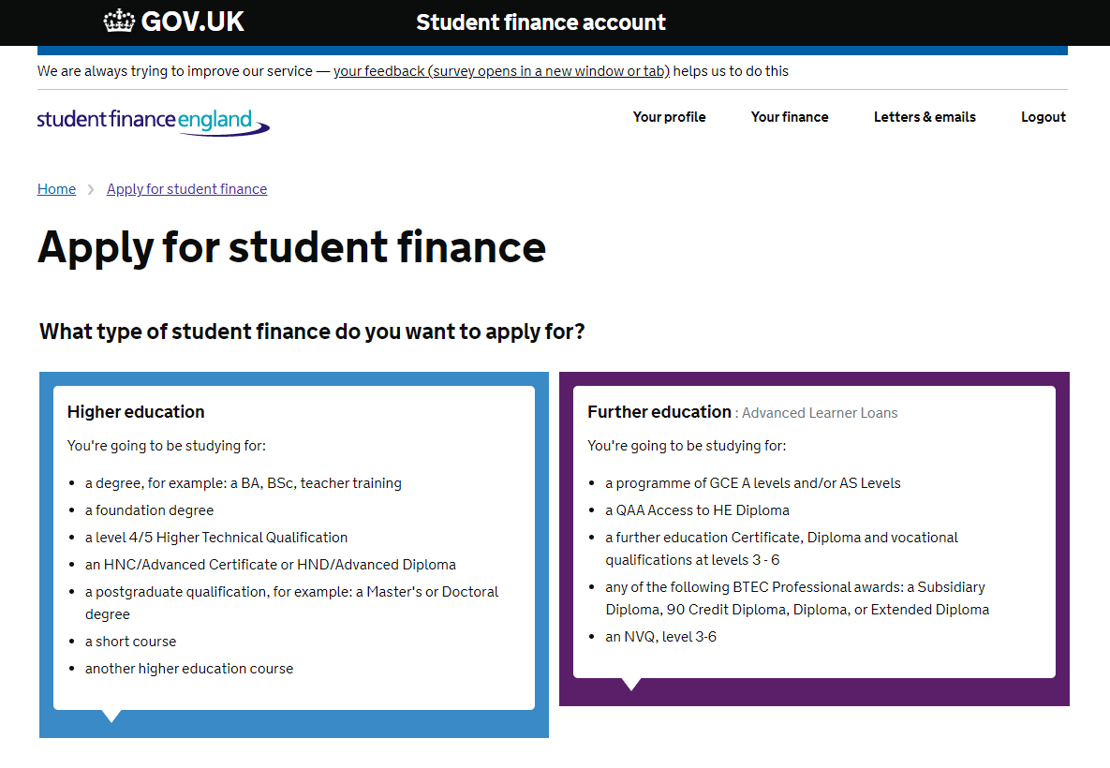

Slide 11
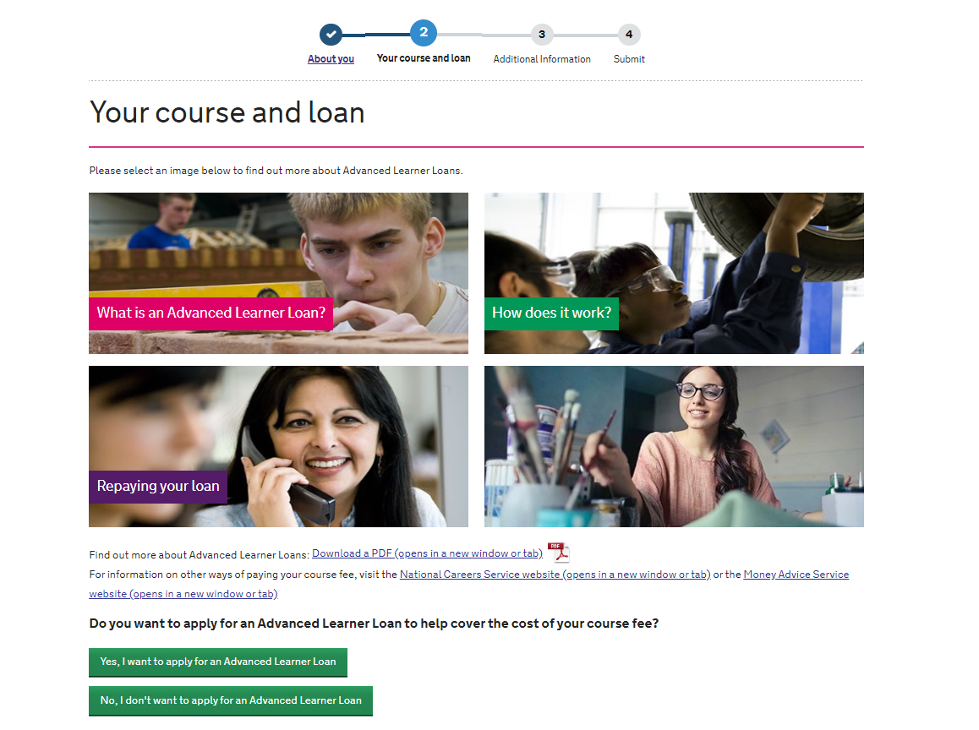
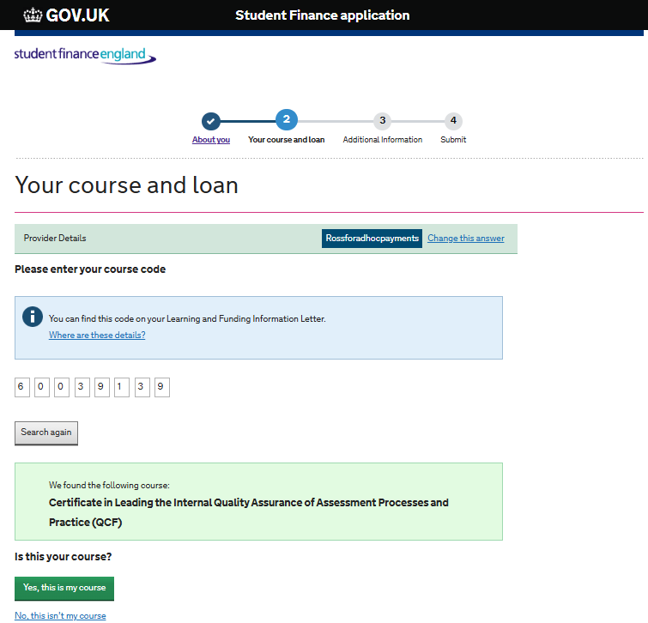

Slide 12
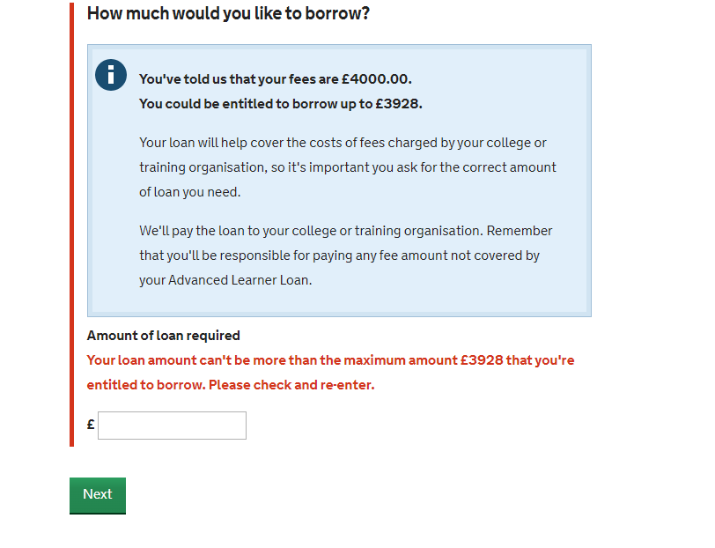
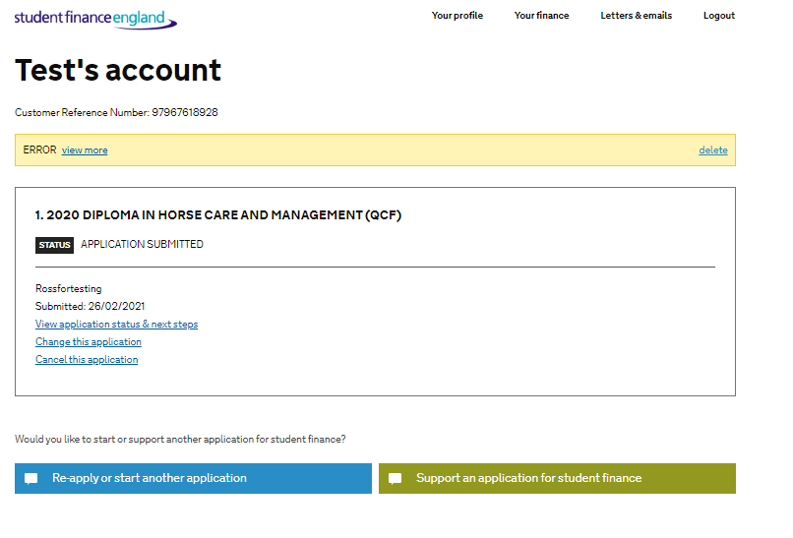
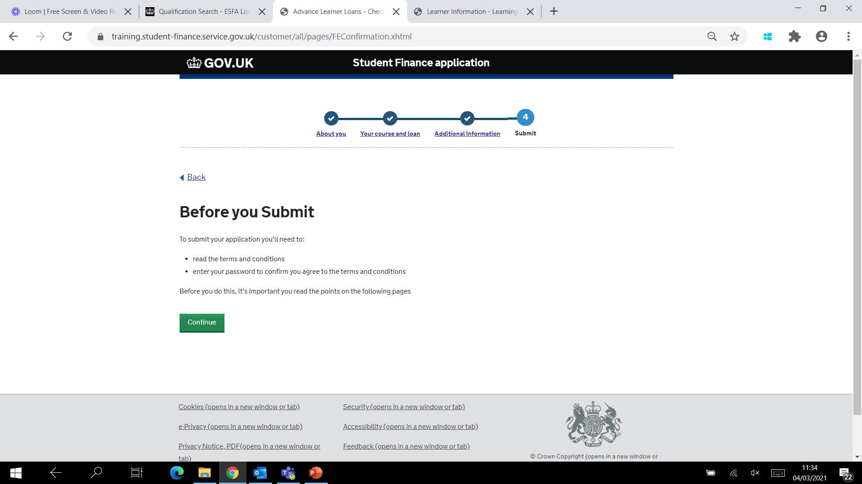

Slide 13

Auto cancellations
Owner | Action | Timeframe
Learner | Auto-cancelled In Data Entry | 30 days
Learner | Auto-cancelled Missing Evidence | 45 days
Learner | Auto-cancelled Eligibility Incomplete | 45 days
Learners are informed we may cancel their application if they don’t return the evidence
We will not issue correspondence for automatically cancelled applications
The application will be reinstated if we receive evidence after it has been cancelled

Slide 14
Service standards

Slide 15
Service standards
‘Right first time’ approach
Check information is correct before confirming attendance
Make sure you submit all required changes before withdrawal
Be mindful of effective date recorded
ILR reconciliation
Accuracy
Within 6 weeks of start date – add ULN and confirm initial attendance
By each fixed quarter drawdown – confirm ongoing attendance
Within 60 days – submit any suspensions and withdrawals
Timeliness

Slide 16
Service standards
ULNs need to be added to the portal within 6 weeks of SLC receiving the application
What percentage of learners’ attendance confirmations need to be submitted from the worklist when it appears on the portal?
85%
SLC allow a maximum of 90 days for providers to submit suspensions or withdrawals, counted from the last day in learning?

Slide 17
Service standards
Process | Submission accuracy | Elapse time to complete
Unique Learning Numbers | 99% | ULNs to be entered within 6 weeks of learning aim start date Where an application is received >4 weeks after learning aim start date, the ULN must be entered within 2 weeks of the application received date
Verification of Study Programme and Notification of Changes | 100% accuracy for approved applications before attendance confirmation | No timescale proposed. It is a condition of Attendance Confirmation that details are correct
Initial Attendance Confirmation | 99% | 85% learner attendance confirmations to be entered within 6 weeks of the learning aim start date if the application is approved Where an application is approved >4 weeks after the learning aim start date, the attendance confirmation must be provided within 2 weeks of the approval date
Subsequent Attendance Confirmations | 99% | 85% Learner attendance confirmations to be provided by payment drawdown date The payment drawdown date is the Thursday prior to the payment date (which is the 3rd Wednesday in the month)
Suspensions | 95% | 70% of suspension CoCs submitted within 60 days of notification AND 95% of suspension CoCs submitted within 90 days of notification
Withdrawals | 95% | 70% of withdrawal CoCs submitted within 60 days of notification AND 95% of withdrawal CoCs submitted within 90 days of notification

Slide 18
Navigating the portal

Slide 19
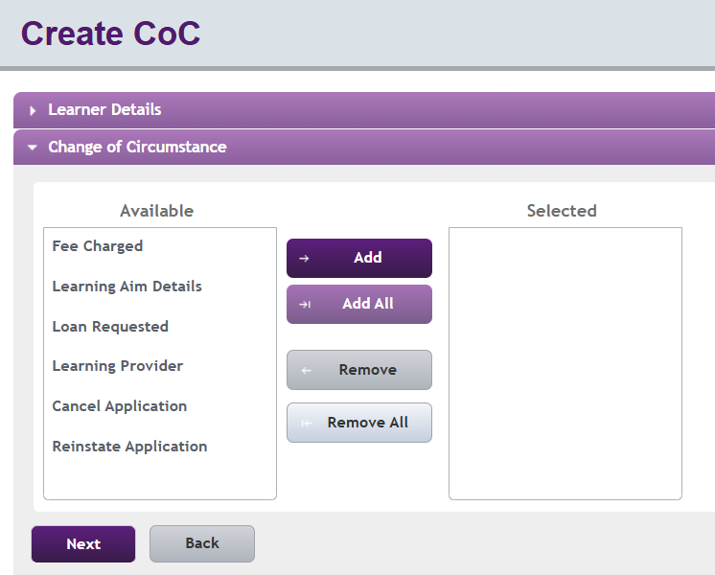
Pre liability changes
The types of changes that can be made at this stage:
change of fee charged
change of loan amount requested (decrease only)
change of learning aim details
change of learning provider
cancellation
re-instatement (if the application is cancelled)

Slide 20
Auto cancellation
Stage | Auto cancel reason | Timeframe
Pre liability | Cancelled: Auto Missing ULN | 90 days
Pre liability | Cancelled: Auto Approved | 90 days
If a learner is a non-starter or does not attend past 2 weeks, you can cancel
You have 60 days to reinstate an application once you have cancelled it
A provider cannot reinstate an auto cancelled application

Slide 21
Scenario 1
Eve’s application is at ‘Missing Evidence’.
She has incorrectly entered the wrong fee for a lower amount.
The provider notices the error on the portal.
What should they do?
Should the provider:
ask the learner to correct the error?
ask the learner to pay the balance?
amend the fee to the correct amount?
do nothing until the application has been approved?
Answer:
The learner can amend the details via their online account.
Otherwise, once the application moves to approved, the provider can submit a Fee Charged CoC.
We will then send a Loan Request Form to the learner.

Slide 22
Scenario 2
Provider notices that LAFILs issued for a cohort of learners have the wrong planned end date.
There are multiple learners that have applied using the wrong end-date.
What should they do?
Should the provider:
ask the cohort of learners to individually alter their end dates?
alter each learner’s account?
amend the end dates using a single CoC for all learners?
Answer:
The provider can submit a single Learning Aim Details CoC to amend the end date for multiple applications.
The learners are then notified via their online account that the provider has made changes.

Slide 23
Scenario 3
Paula has decided to transfer to a different course in agreement with her provider.
It’s the same level and type.
It’s also designated for Advanced Learner Loans funding.
What should they do?
Should the provider:
issue a new LAFIL
issue a new LAFIL and ask the learner to reapply using the new course information?
submit a CoC making the alterations to the existing application?
Both a and c
Answer:
The provider can change the learning aim.
The provider should issue a new LAFIL to Paula.
The provider should submit a Fee Amount CoC (if necessary).
If the fees are higher, we’ll need the learner to complete a Loan Request Form.

Slide 24

Portal functionality
Learner details
Attendance confirmations
Change of circumstances
User access levels
LP details
Reporting functions

Slide 25
Confirming attendance
Initial attendance confirmation | Two weeks after the start of the learning aim
Subsequent (quarterly) | Attendance confirmation points fixed at 1 August, 1 November, 1 February and 1 May
Assumed attendance | Attendance is assumed on months in between fixed quarters
Stage | Auto cancel reason | Timeframe
Pre-liability | Approved with missing ULN | 90 days
Pre-liability | Approved with no attendance confirmation (initial) | 90 days
Post-liability | Approved with no attendance confirmation (subsequent) | 365 days

Slide 26
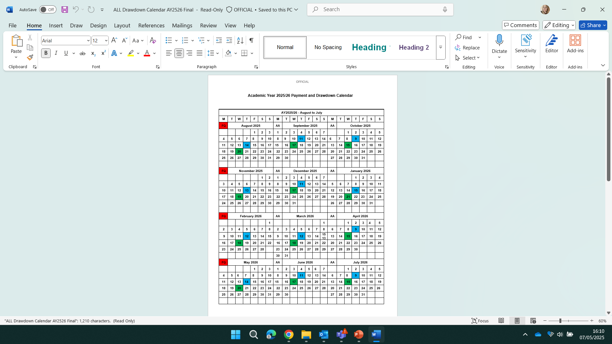
Course dates: 11.09.2025 to 06.07.2026
What learner information should you check before confirming attendance?
When would an initial attendance confirmation be available?
Which months are subsequent attendance confirmations due?
When would you expect the first payment to be made?
Learner and Learning
Aim information is accurate
25 September 2025
November February
May
15 October 2025

Slide 27
Portal functionality
Learner details
Attendance confirmations
Change of circumstances
User access levels
LP details
Reporting functions

Slide 28
Change of circumstances
Post liability: after initial attendance confirmed
  Providers can make the following changes:
  Change of fee charged
  Change of loan amount requested (decrease only)
  Change of learning aim details
  Early completion
  Suspension
  Resumption
  Withdrawal

Slide 29
Good to know
A learner can go on a break in learning (suspension) for up to 12 months
Learners can have repeat periods of suspension
A withdrawal means the point when a learner’s scheduled learning, teaching and assessment activities end, and they do not intend to return
A withdrawal is final and learners cannot change their mind
Once a withdrawal is submitted, this terminates their period of student finance eligibility. We'll recalculate their loan liability based on the withdrawal date
Each learning provider should have their own fee and attendance management policy

Slide 30
Post liability considerations
You cannot increase fee amount after course end date
You cannot change start date once initial attendance confirmed
Once the end date has passed it cannot be amended
Changes to the learning aim must be at the same level and type
You cannot alter ‘in attendance’ confirmation after drawdown

Slide 31
Zero fee guidance
Scenario | Action
Learner entitled to grant funding for a first full level 3 qualification, but loan application approved and attendance confirmed
A learner has completed their learning aim, but the provider decides to remove their loan liability
A learner has not completed their learning aim, and the provider decides to remove their loan liability
A learners’ attendance has been confirmed in error, and they did not start their learning aim
Set the Fee Amount to zero and leave at Approved
Set the Fee Amount to zero and leave at Approved
Set the Fee Amount to zero and withdraw back to the last date of attendance
Set the Fee Amount to zero and withdraw back to the earliest point – day 15

Slide 32
Suspensions and withdrawals
Statement | True or false
Future payments for suspended learners are not included in the ‘Amount Used’.
If the learner does not resume, the effective withdrawal date should match the last date of attendance.
If a learner’s withdrawal date is wrong on the LP Portal, this will impact their repayment date and interest.
If a learner withdraws on 1 May, attendance needs to be submitted for May before the withdrawal.
False – future payments remain scheduled for suspended learners.
True – ensure effective date is in line with effective date of suspension.
True – the learner’s course end date (or withdrawal date) determines Statutory Repayment Due Date (SRDD).
True – learners are liable for any period of attendance in a month.

Slide 33
Financial reporting

Slide 34
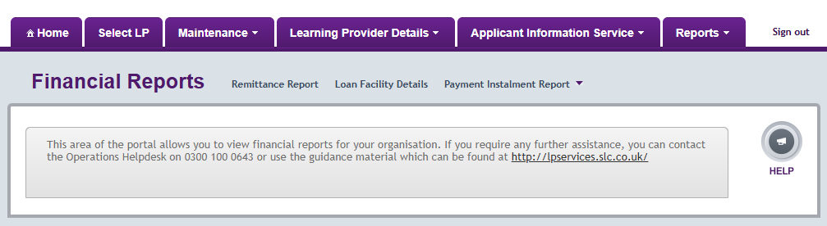
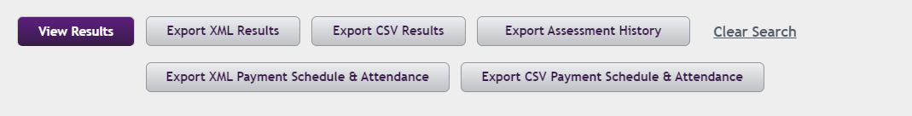
Financial reports

Slide 35
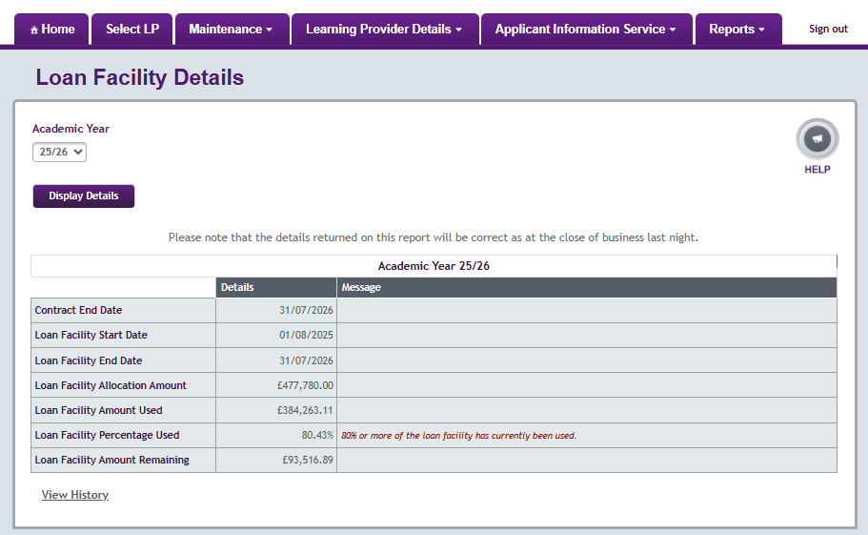
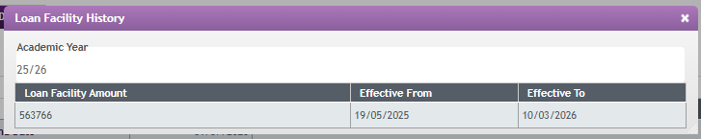
Loan facility details

Slide 36
Warning messages
Loan facility percentage used | Message on LP Portal | Email generated
80% | ✓ | ×
90% | × | ✓
100% | ✓ | ✓

Slide 37
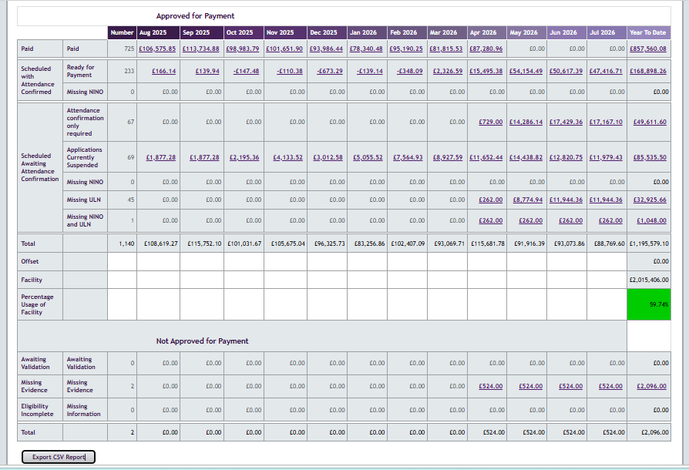
Payment instalment report

Slide 38
Challenges and things to consider
One performance management point (PMP) from 2026/27 – January
90% threshold
Growth and reductions calculated using a formula based on provider performance rather than through bidding or business case submissions
Forecasting and planning crucial:
    If you want to be in scope for growth
    If you want to maintain or increase loan facility contract for 2027/28

Slide 39
Financial reporting
Drawdown date
Thursday prior to the payment date
Payment date
Payment made if attendance confirmed by close of business on draw down date
Always the third Wednesday of every month
No interim or catch-up payments in month
Financial reports
Payment Instalment Report and Remittance updated Friday after drawdown
Updated overnight

Slide 40


Monitoring your facility
Course 12 July 2025 to 9 July 2026
Auto restriction applied to 2024/25 as at 100%
The learner will be made ineligible
As there is a payment scheduled in 2024/25 (July) the application will be made ineligible

Slide 41
Maximising your facility
Course start date 17 July 2025
First payments scheduled for 31 July 2025
First payments made August
Full loan will be attributed to AY 2026/27 loan facility
Although the first payment is not due until August, the first payment is scheduled in July
This means that the July instalment will be attributed to 2024/25 loan facility usage

Slide 42
Overpayments
Where we’ve made an overpayment, SLC will claw this back from future payments
SLC will offset this overpayment against the next payment made to the provider
Provider will receive their monthly payment, minus any overpayment

Slide 43
Learner repayment process

Slide 44
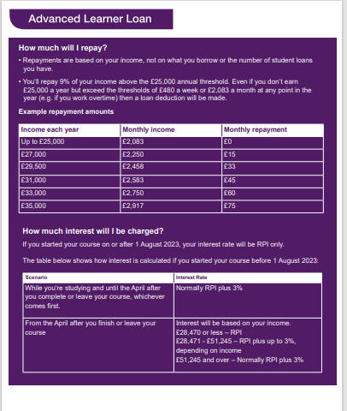
Student loan repayment
Plan 5 from August 2023
Threshold £25,000
Repay 9% above threshold
Interest RPI during study
Cancelled after 40 years

Slide 45
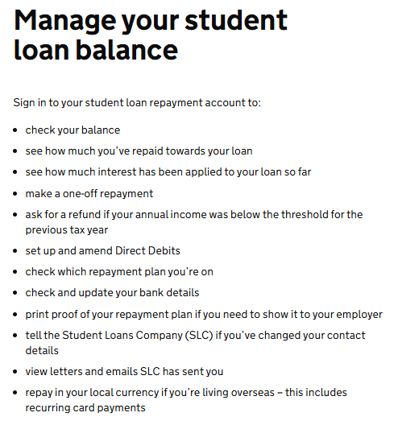
Student loan – managing the balance
Learners can visit GOV.UK to check loan balance
To sign in, they will need:
customer reference number or email address
password
secret answer, for example their mother’s maiden name
Manage your student loan balance - GOV.UK

Slide 46
Academic year preparation
2026/27

Slide 47
Milestones
Timeline
Publication of DfE funding and performance rules
Application launch for ALL
PMP2 outcomes applied
PMP outcomes applied
March 2026
April 2026
May 2026
June 2026
Jan 2027
March 2027
April – July 2027
Learner applications
PMP review point
2026/27 contracts issued
LAFIL template published
Max loan rates published
Learning Aims approved for funding

Slide 48
Academic year readiness
Contracts Manager to review AY 2026/27 loan facility contract promptly
Ensure AY 2026/27 loan facility is visible on LP Portal ahead of application service launch
Do not issue LAFILs before launch to avoid applications being made ineligible
Make sure learning aims are approved for AY 2026/27
Review LP Portal contacts and user list ahead of new academic year
Be mindful of processing times, especially during ‘peak’ times

Slide 49
Recap
When is an application automatically cancelled if evidence is missing?
A. 30 days
B. 45 days
C. 60 days
D. 90 days
Who is responsible for making payments to providers?
A. Department for Education (DfE)
B. Learning Provider
C. Student Loans Company (SLC)
D. Office for Students (OfS)
✅ Answer: B
✅ Answer: C
How many loans can a learner normally apply for?
A. up to 2 loans total
B. up to 3 loans total
C. up to 4 loans total
D. unlimited loans
✅ Answer: C

Slide 50
Recap
What happens to payments when a learner is suspended?
A. payments stop immediately and are clawed back
B. payments continue as normal
C. payments are frozen from the following month
D. payments are doubled
How long should it take for a NINO to be verified?
immediate response
48 hours
no longer than 14 days
1 week
✅ Answer: C
✅ Answer: C
What percentage of attendance confirmations must be submitted on time?
A. 70%
B. 75%
C. 85%
D. 95%
When are loan repayments cancelled?
A. after 25 years
B. after 30 years
C. after 35 years
D. after 40 years
✅ Answer: D
✅ Answer: C

Slide 51
Further education
Sector updates

Slide 52
Lifelong Learning Entitlement (LLE)
Non OfS registered providers:
ALL funding to remain for L4 to 6 until 2029/30
Option to register – cost impact analysis
Option to become a franchisee
Exit L4 to 6 market from 2030/31
OfS registered providers:
Level 3 provision funded via ALL
L4 to 6 provision funded via LLE for course start dates Jan 2027 onwards
Clear IAG required for mid year starts
Option to modularise with prior DfE agreement
Level 3 only from 2030/31
Once LLE is implemented, DfE will launch the LLE qualifications gateway.
This will allow awarding organisations to apply for LLE funding designation.

Slide 53
Useful contacts and resources
Partners Support Desk - lpservices@slc.co.uk / 0300 100 0643
Practitioner Support - SSIN_Queries@slc.co.uk / 0300 100 0618
For detailed information regarding policy, regulations, eligibility or
circumstantial questions. Select Option 1.
Practitioners website
DfE Funding Rules 2026/27
LAFIL template and guidance
Transfer of ALL to LLE - list of approved qualifications

Slide 54

FE Account Management Team
lpservices@slc.co.uk
www.gov.uk/slc

