Slide 1
Learning Provider Regional Forums
FE Account Managers
Partner Services
March 2025

Slide 2
Advanced Learner Loans
Trends & Data

Slide 3
SLC Contact Drivers
Administrative errors
Reverse withdrawal requests
Missing evidence queries
Portal issues e.g. attendance and withdrawals
Level 3 entitlement – how to correctly alter learner records if free funding available

Slide 4
Top 10 Learning Aims
Level | Learning Aim Type | Learning Aim Description
Level 3 | QCF Diploma | Diploma in Nail Technology
Level 3 | QCF Diploma | Diploma in Combined Beauty Therapy Skills (RQF)
Level 4 | QCF Diploma | Diploma in Therapeutic Counselling (RQF)
Level 3 | Vocational Qualification | Diploma in Gym Instructing and Personal Training
Level 3 | QAA Access to HE | Access to HE Diploma (Health Science Professions)
Level 3 | QCF Diploma | Diploma in Supporting Teaching and Learning
Level 3 | QCF Diploma | Diploma in Business and Management
Level 3 | QCF Diploma | Foundation Diploma in Art and Design
Level 3 | QCF Diploma | NVQ Diploma in Beauty Therapy Massage
Level 4 | QCF Diploma | Diploma in Therapeutic Counselling

Slide 5
Opportunities
Do you make of use of SLC websites?
Do you promote distance learning courses?
Are you having the correct IAG conversations?
How do you raise awareness of ALL funding?

Slide 6
Advanced Learner Loans
SLC Updates

Slide 7
SLC Updates
25/26 Launch
Processing Updates
Home Office Data Share (HODS)
Access to HE Write Off

Slide 8
SLC Updates
Service Launch – mid June
Operational changes reflecting new HODS process
HODS – new Home Office Data Share process successfully introduced
Access to HE - promote to learners if no alternative funding streams are available
reminder that write off is still available on completion of HE course

Slide 9
Advanced Learner Loans
Sector Insight

Slide 10
Sector Insight
New Funding Contracts
DfE / ESFA
Lifelong Learning Entitlement
40 new providers have joined ALL in A/Y 24/25
ESFA transfer of functions to the DfE; this change took effect from 1st April 2025
LLE - next update June 2025

Slide 11
Responsibilities as of 1 April 2025
SLC
Loan application process
Loan facility payments via the provider portal
Provider service level agreements, including confirmation and change
HMRC repayment process
Events programme
Account management
Monitoring of service standards compliance
DfE
Policy intent
Designating qualifications
Provider and agreement management
Market entry/exit
ALL Bursary payments
Funding Rules
Allocations
Performance Monitoring
Assurance Audits
Investigations

Slide 12

Lifelong Learning Entitlement - 2025
Provider Preparation Guide published – Feb 2025
DfE announcement due June 2025. Should include:
The regulation of providers under LLE with OfS
Maintenance loans
Supplementary grants
Priority courses and additional entitlement
Information on the expansion and regulation of modular funding with the OfS
SLC IAG Webinars – July / August 2025
SLC Seminars – November 2025

Slide 13
Advanced Learner Loans
2025/26 Timelines

Slide 14





2025/26
Loan cap remains unchanged
25/26 contract Spring 25
ESFA Funding Rules to be published early April 25
Performance Management Points -
PMP1 October 25
PMP2 January 26
Criteria for growth –
Refer to guidance

Slide 15
Monitoring your Facility
Learning & Funding Information Letter
Accuracy
Timing
Performance Management Points
Exception Case Form
Approved / Suspended included in amount ‘used’
Growth notification to portal upload
LP Portal Financial Reports
Loan Facility Details
Payment Instalment Report

Slide 16
Advanced Learner Loans
Service Standards & Best Practice

Slide 17
Service Standards
Service standards introduced 2016
Overall high levels of compliance
Shift in focus - timeliness and accuracy
Potential future changes to align with HE / LLE

Slide 18
Service Standards
Process | Submission Accuracy | Elapse Time to Complete
Unique Learning Numbers | 99% | ULNs to be entered within 6 weeks of learning aim start date Where an application is received >4 weeks after learning aim start date, the ULN must be entered within 2 weeks of the application received date
Verification of Study Programme & Notification of Changes | 100% accuracy for approved applications before attendance confirmation | No timescale proposed. It is a condition of Attendance Confirmation that details are correct
Initial Attendance Confirmation | 99% | Learner attendance confirmations to be entered within 6 weeks of the learning aim start date if the application is approved Where an application is approved >4 weeks after the learning aim start date, the attendance confirmation must be provided within 2 weeks of the approval date
Subsequent Attendance Confirmations | 99% | 85% Learner attendance confirmations to be provided by payment drawdown date The payment drawdown date is the Thursday prior to the payment date (which is the 3rd Wednesday in the month)
Withdrawals | 99% | 60% of withdrawal CoCs submitted within 60 days of notification AND 99% of withdrawal CoCs submitted within 90 days of notification
Suspensions | 99% | 60% of suspension CoCs submitted within 60 days of notification AND 99% of suspension CoCs submitted within 90 days of notification

Slide 19
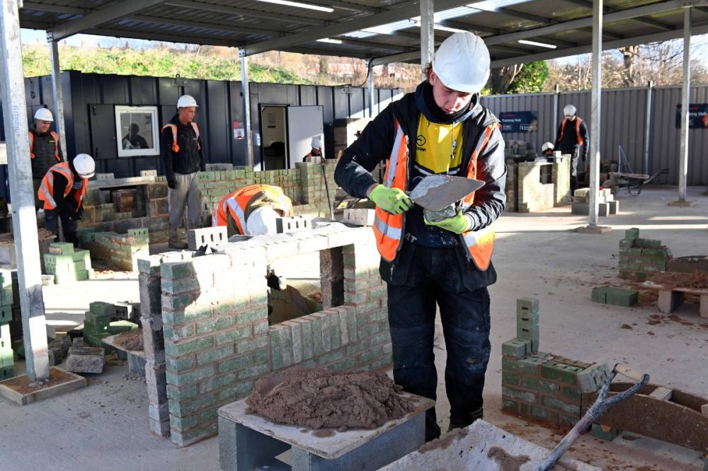
Attendance Management
Processes used to track, record and manage a learner's engagement, participation and attendance on their course, including enrolment, during study and on withdrawal or completion of the course
All providers should have Attendance Management policies and processes, whether formally documented or not
Student Finance Regulations rely on providers’ Attendance Management Policies to ensure timely and accurate administration of the Advanced Learner Loans

Slide 20


Impact on learner
Suspensions & Withdrawals
Impact on provider
Funding recalculated based on the last month of attendance
SLC will seek immediate recovery of any finance paid when the learner wasn’t in attendance
Learner will receive a new entitlement letter detailing any changes to funding
Late withdrawals may mean recalculation of interest rates
Any overpayments will be clawed back on the next payment run
Important to have regular checks of attendance as payments automatically issued for the ‘assumed months’
Late withdrawals impact on service standard compliance and could jeopardise growth requirements

Slide 21
Advanced Learner Loans
Academic Year Readiness

Slide 22
Academic Year Readiness
Contracts manager to digitally sign and return 25/26 loan facility contract promptly
Ensure 25/26 loan facility is visible on LP portal ahead of application service launch
Ensure LAFILs are not issued ahead of launch to avoid applications being made ineligible
Review contacts and user list ahead of new academic year
Be mindful of processing times, especially during ‘peak’ times
Ensure you have a robust attendance management policy

Slide 23
Over to you
Implement best practices
Contribute to continuous improvement – portal, guidance
Focus on accuracy and timeliness
Drive down suspensions and withdrawals - 90 to 60 days

Slide 24
Further Support & Resources
Partners’ Support Desk
lpservices@slc.co.uk / 0300 100 0643
Practitioner Support
SSIN_Queries@slc.co.uk / 0300 100 0618
For detailed information regarding policy, regulations, eligibility or circumstantial questions
LLE Provider Preparation Guide
https://www.heinfo.slc.co.uk/lle/lle-resources/
Practitioners’ Website
https://www.practitioners.slc.co.uk/supporting-materials/
ESFA Funding Rules 2024/25
https://www.gov.uk/government/publications/advanced-learner-loans-funding-rules-2024-to-2025/advanced-learner-loans-funding-rules-2024-to-2025

Slide 25

Learning Provider Regional Forums
LP_Services@slc.co.uk
www.gov.uk/slc

